Slide 1


Climate & Carbon
Challenges
Malte Meinshausen
Climate & Energy College
Energy Transition Hub
University of Melbourne
Lead Author IPCC WG1 AR6
11 April 2019, Engineers Australia event
climatecollege.unimelb.edu.au
Energy-transition-hub.org

Slide 2
Overview
What are current emission trends?
The carbon budget for 1.5°C and 2.0°C
What is Australia’s fair share?
An example for the impacts: sea level rise and coral bleaching
The light on the horizon

Slide 3
Emission trends

Slide 4
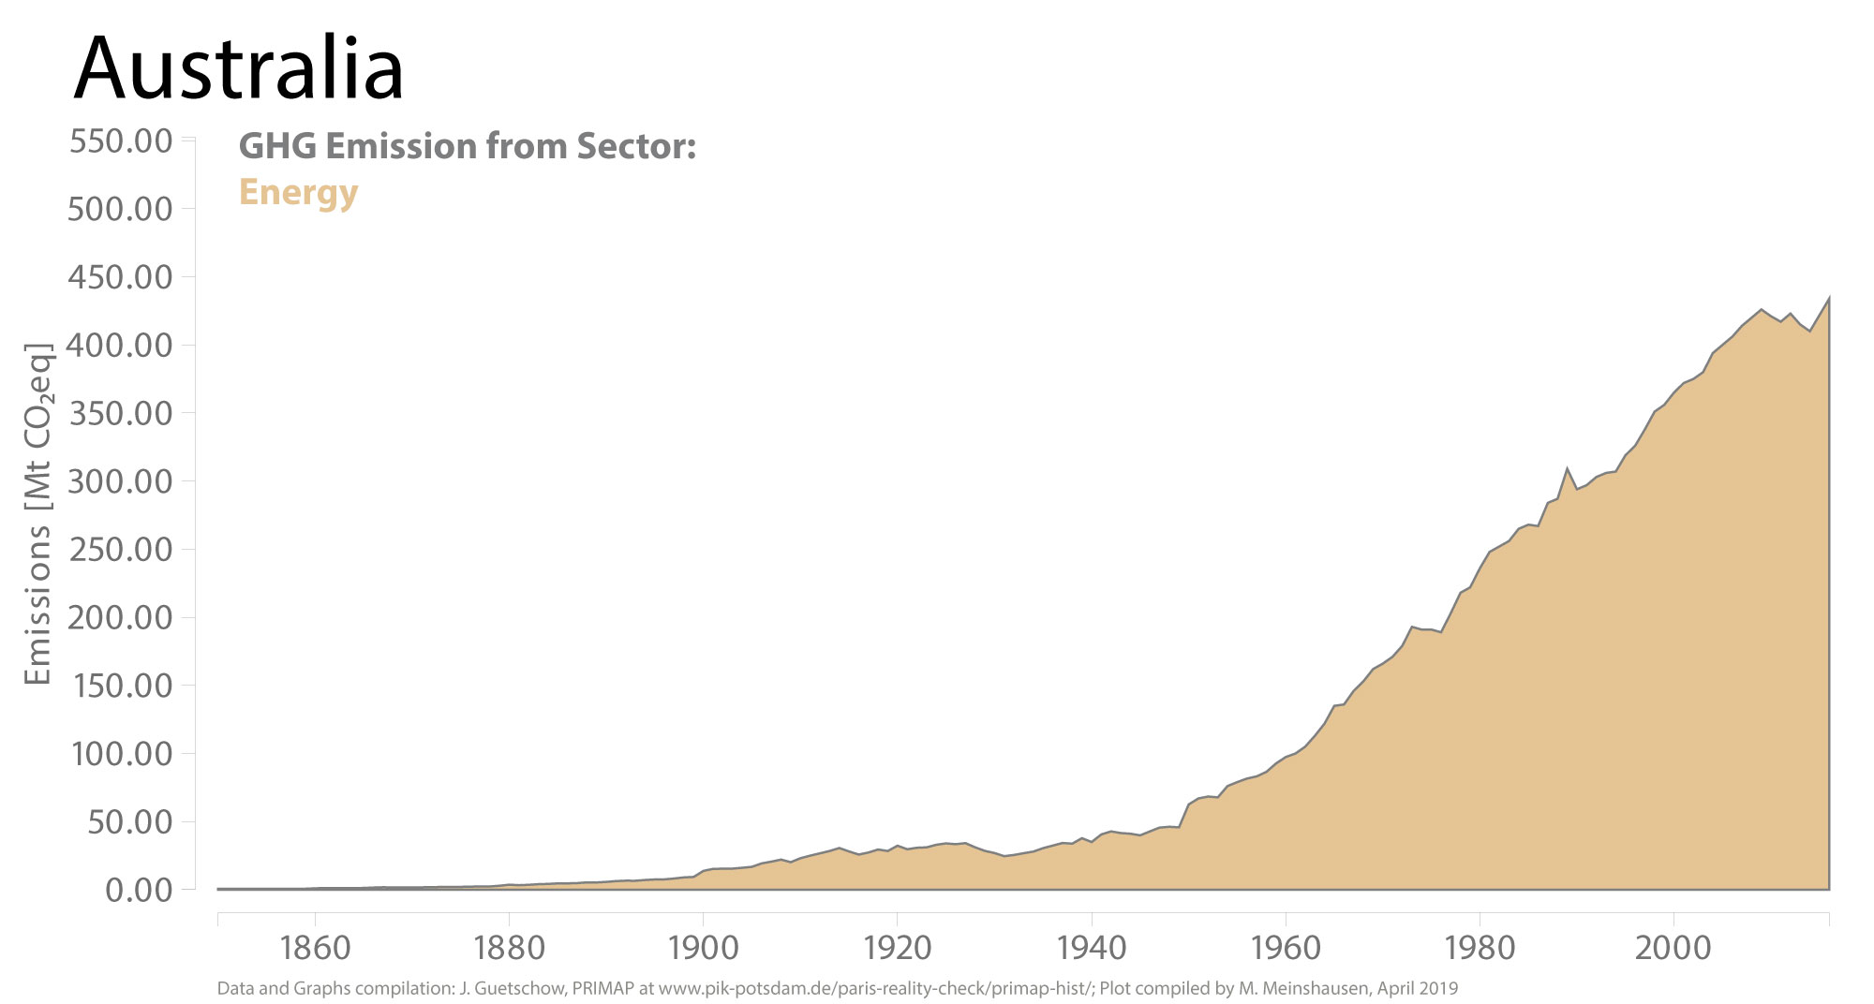

Slide 5
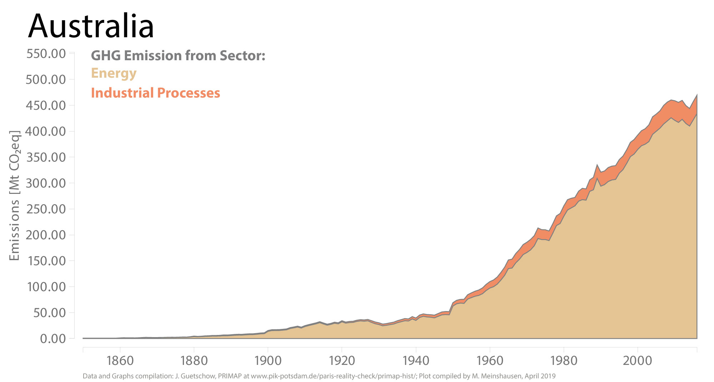

Slide 6
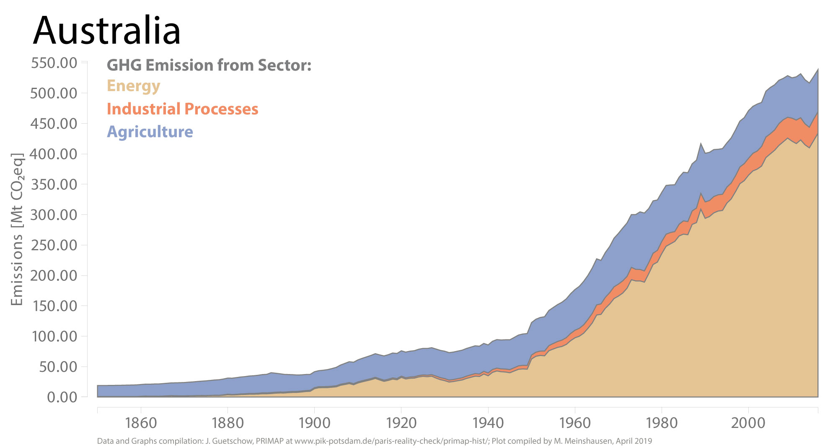

Slide 7
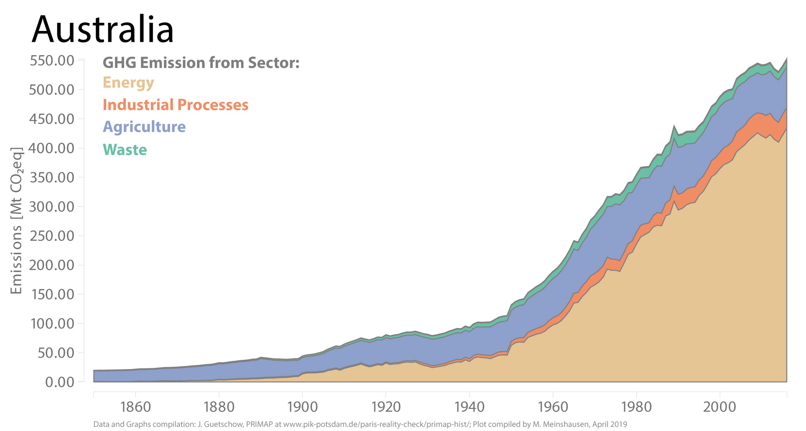

Slide 8
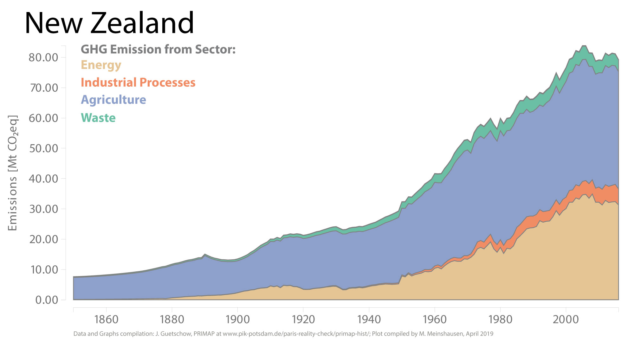

Slide 9
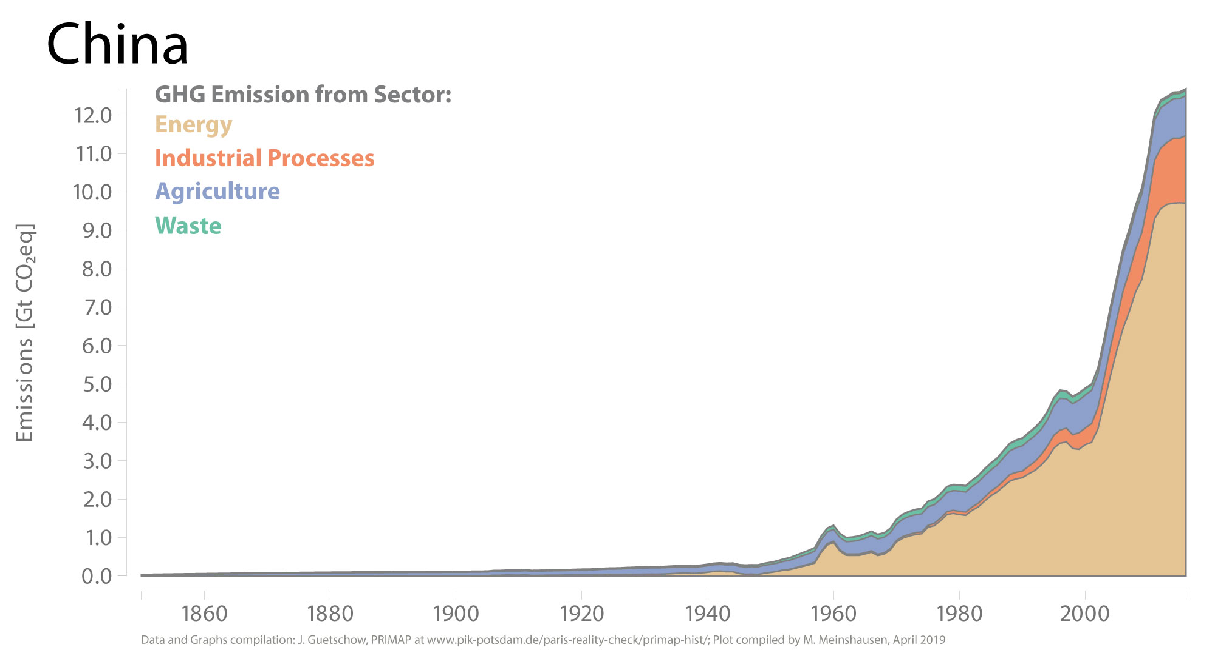

Slide 10
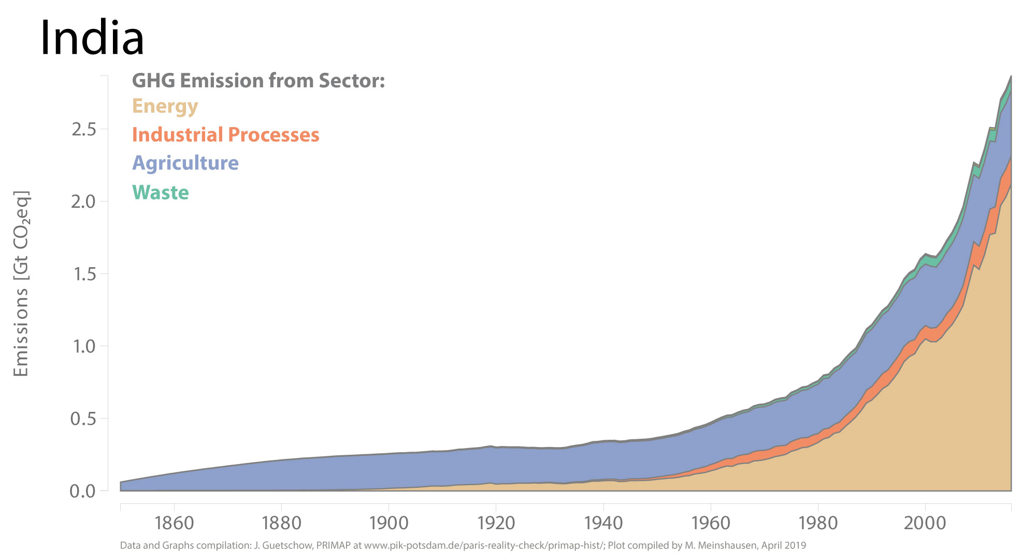

Slide 11
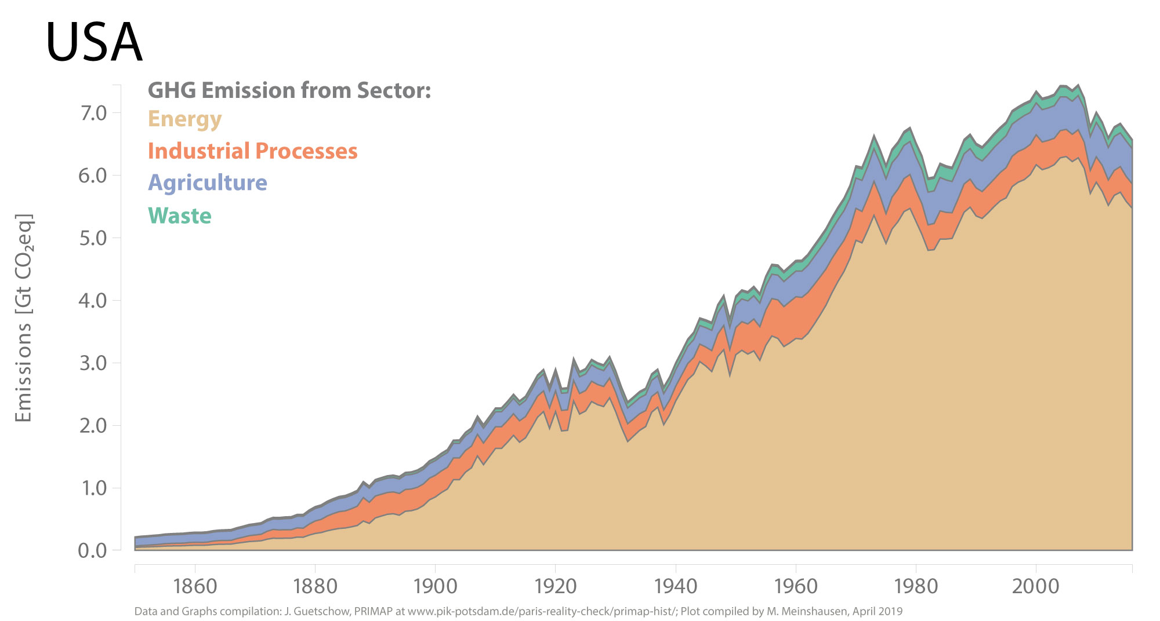

Slide 12
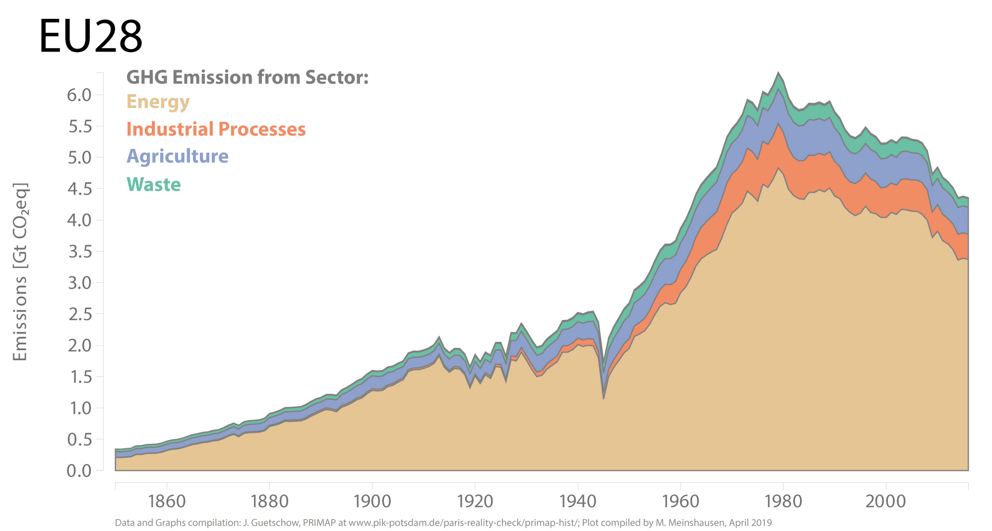

Slide 13
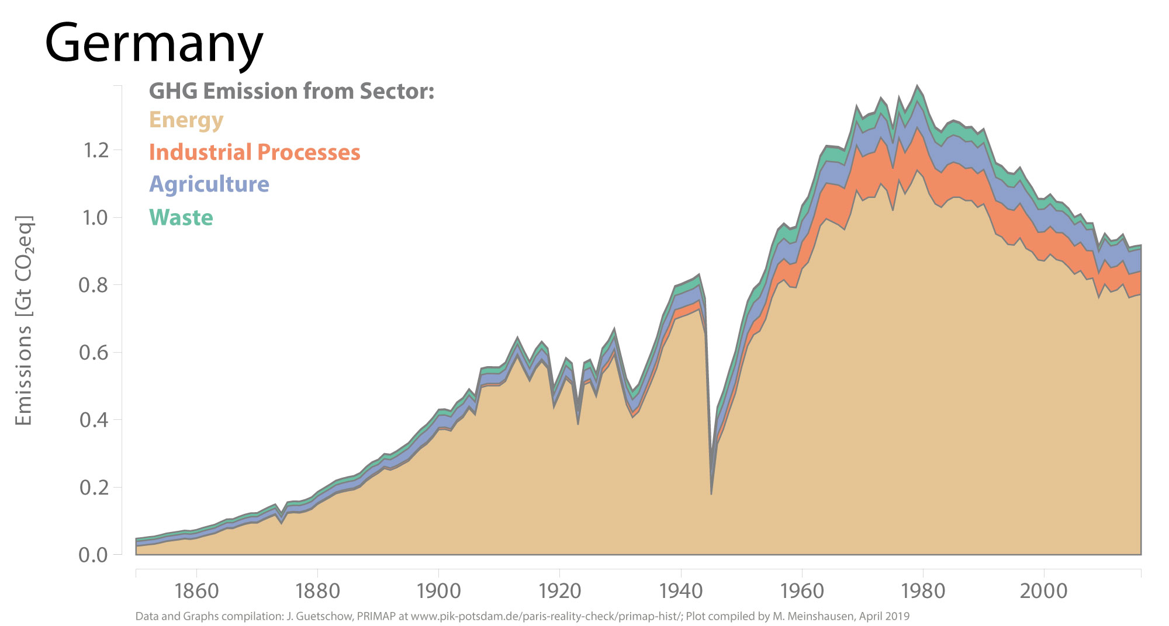

Slide 15
Remaining carbon budgets to stay well below 2°C or 1.5°C warming

Slide 16
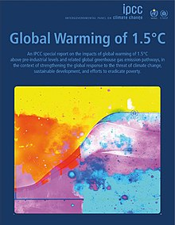
IPCC Special Report on 1.5C warming
Central figure for 50% below 1.5C in final draft – consistent surface air temperature. Relative to early-industrial, 1850-1900, not pre-industrial

Slide 17
IPCC Special Report on 1.5C warming
Permafrost feedback effects further reduce carbon budget by 100 GtCO2 (or one would need to assume 100 GtCO2 negative emissions after 2050)

Slide 18
IPCC Special Report on 1.5C warming
~0.43
~375
If the 1.5°C target is taken relative to pre-industrial levels, i.e. ~1750, rather than early-industrial levels from 1850-1990, then another 0.1K needs to be subtracted from 0.53K, resulting in ~400 GtCO₂ carbon budget (~275 GtCO₂ with taking permafrost into account).

Slide 19
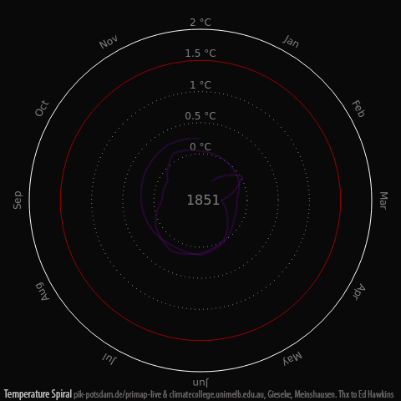

Slide 20
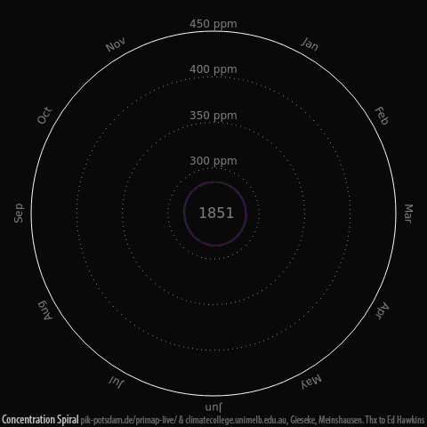

Slide 21
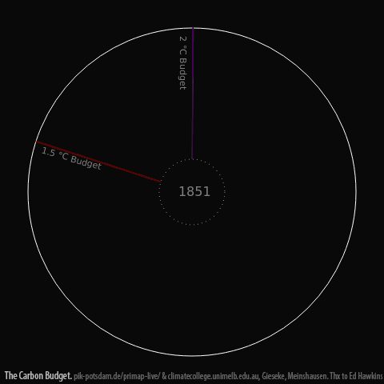

Slide 22
Paris Agreement pledges to 2030 and how they compare to the carbon budgets

Slide 23
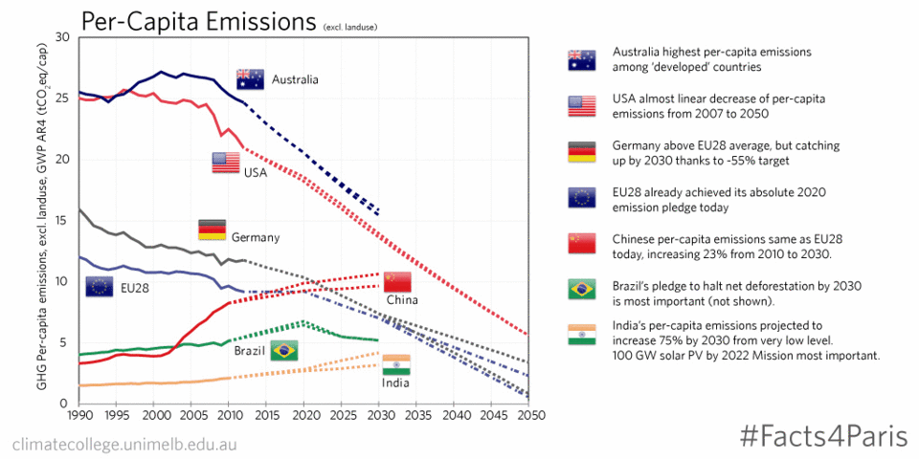

Slide 24
What would be fair emission shares?

Slide 25
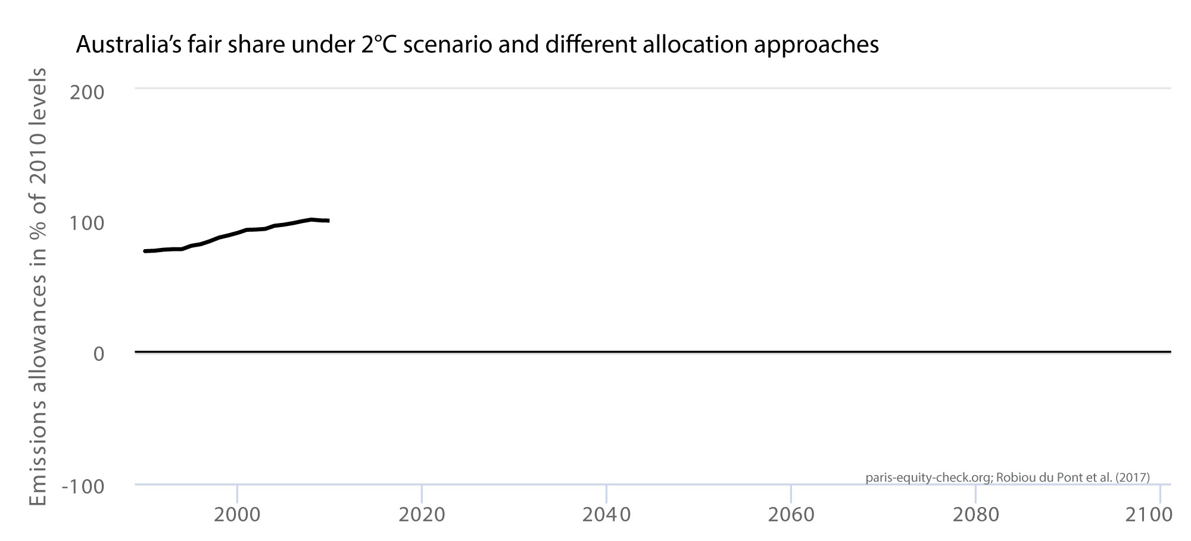

Slide 26
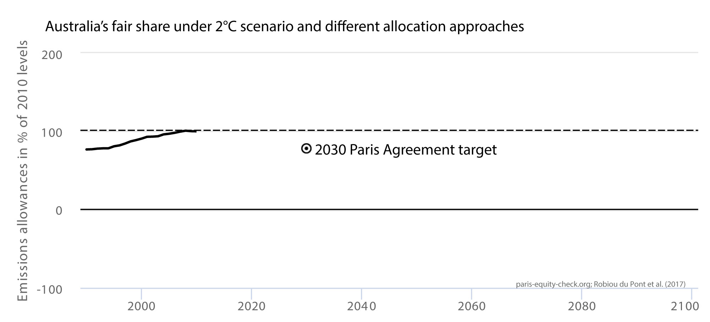

Slide 27
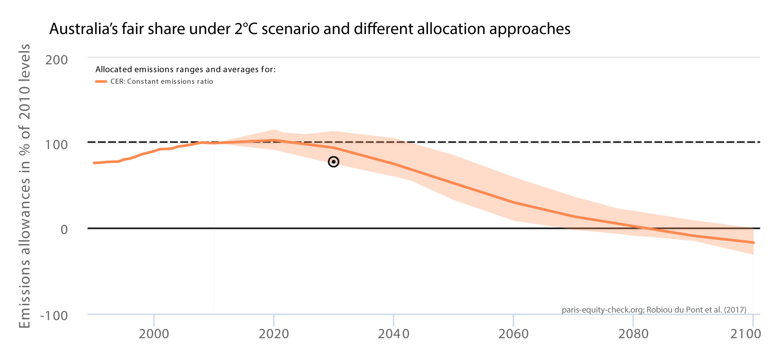

Slide 28
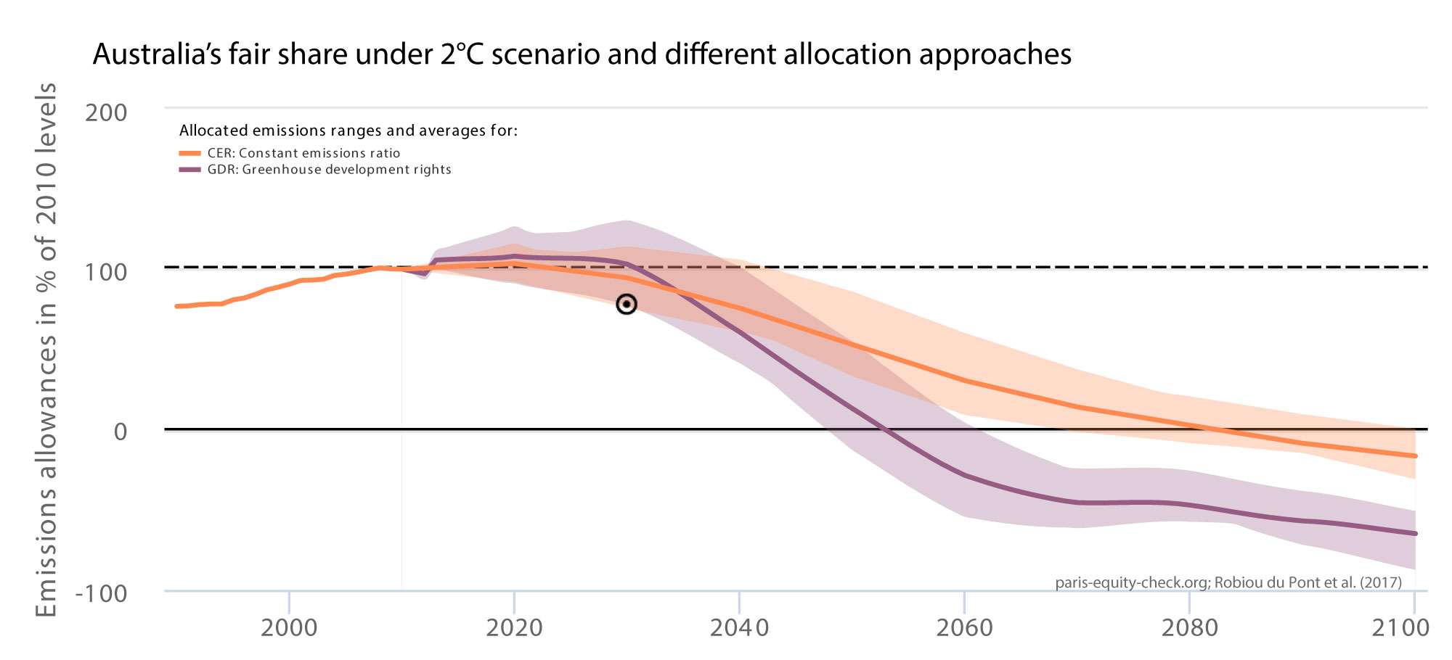

Slide 29
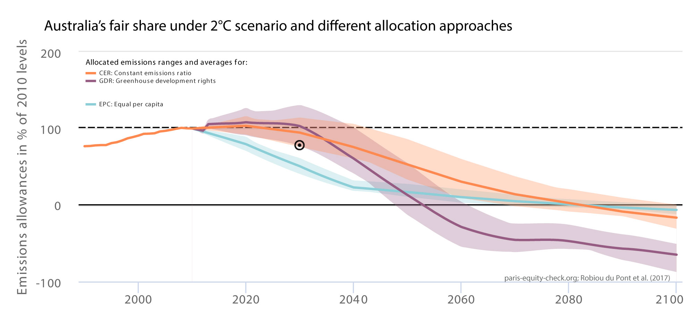

Slide 30
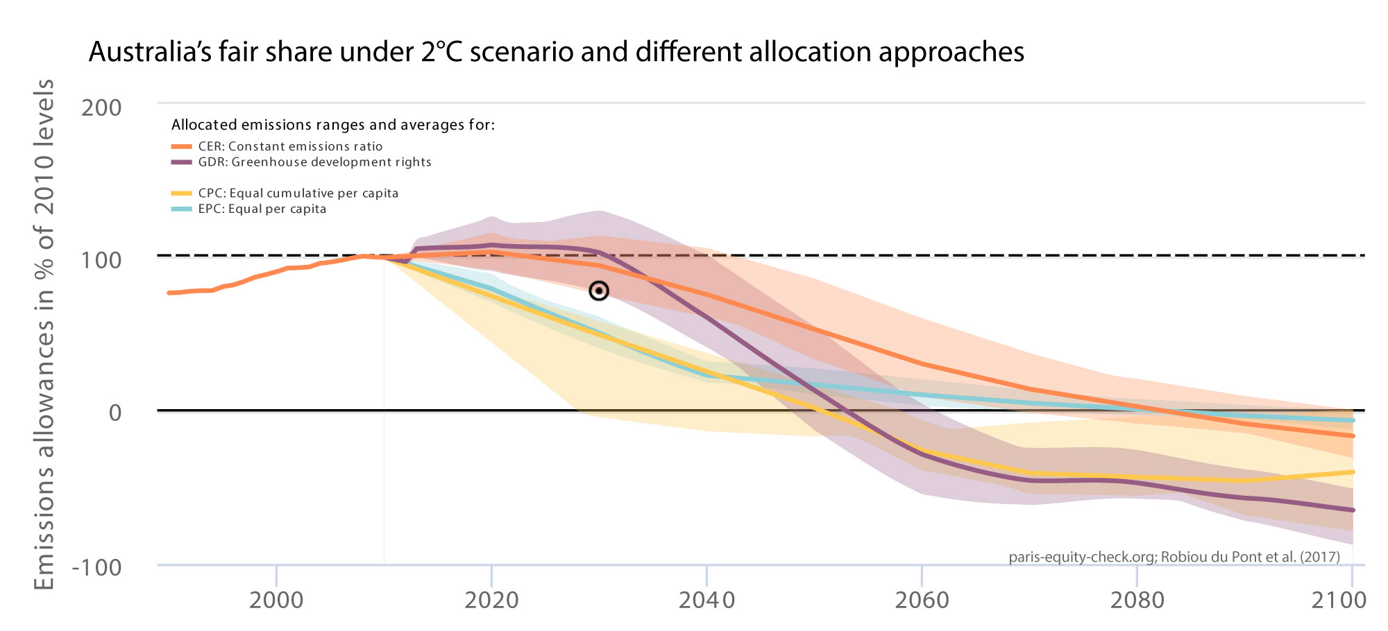

Slide 31
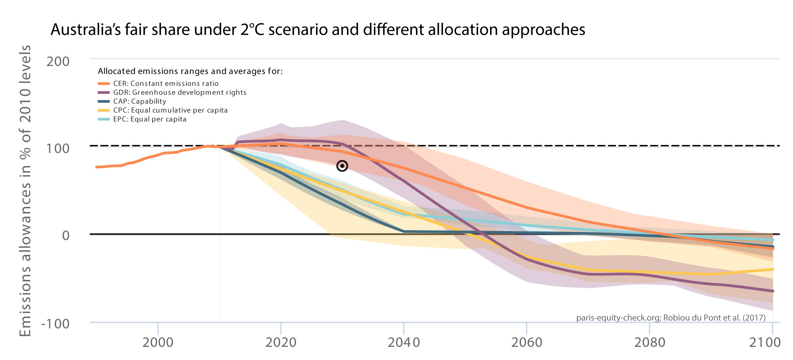

Slide 32
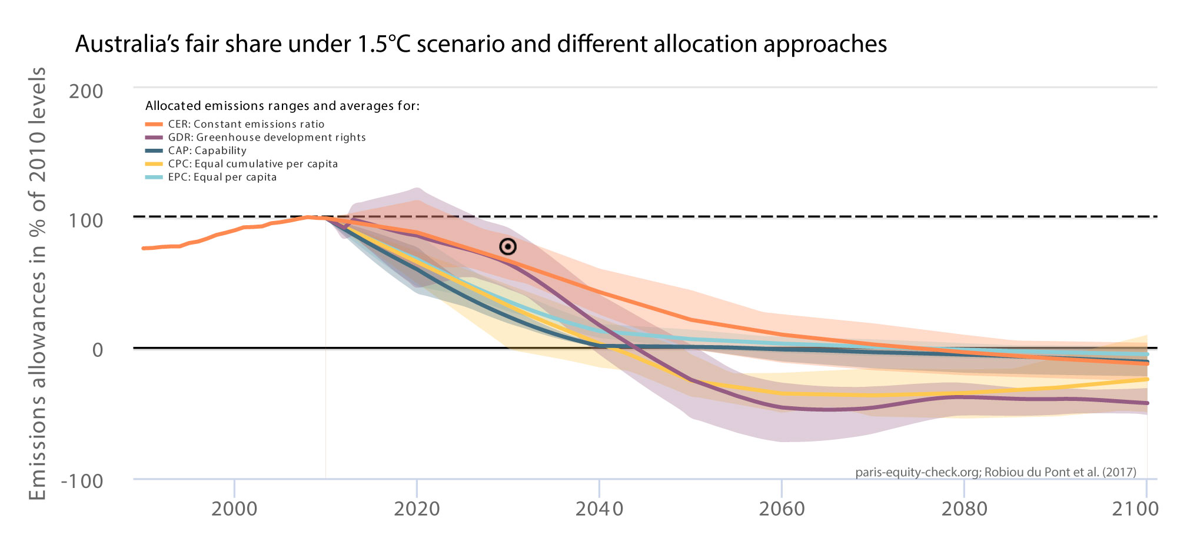

Slide 33
Example for impacts: Sea Level Rise

Slide 34
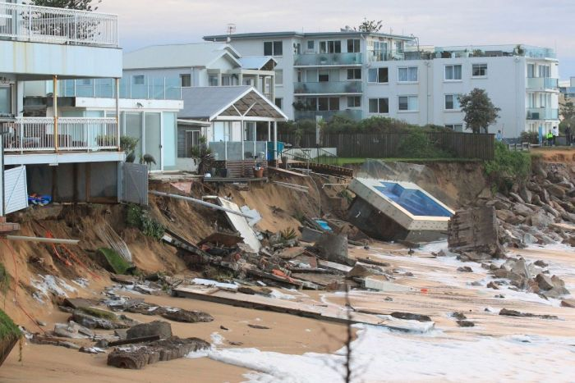
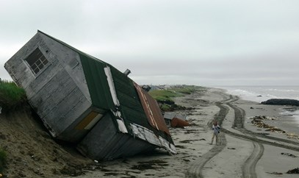
Why do sea levels change at our coasts?
On short time scales:
Tides
Storm surges
Local changes in ocean currents
Inverse Barometer effect
[…]
But there are longer term trends…
Upper picture, East Coast Storm impacts near Collaroy, Sydney, NSW, 6 June 2016;
http://www.abc.net.au/news/2016-06-06/coastal-monitoring-needed-to-protect-against-storms/7482716
Lower photo from NPS: https://www.nps.gov/bela/learn/nature/climate-change.htm

Slide 37
Regional sea level rise projections
For a 1m sea level rise, why are the oceans not distributing the water such that there is a uniform 1m regional sea level rise?
Slangen et al 2014

Slide 38
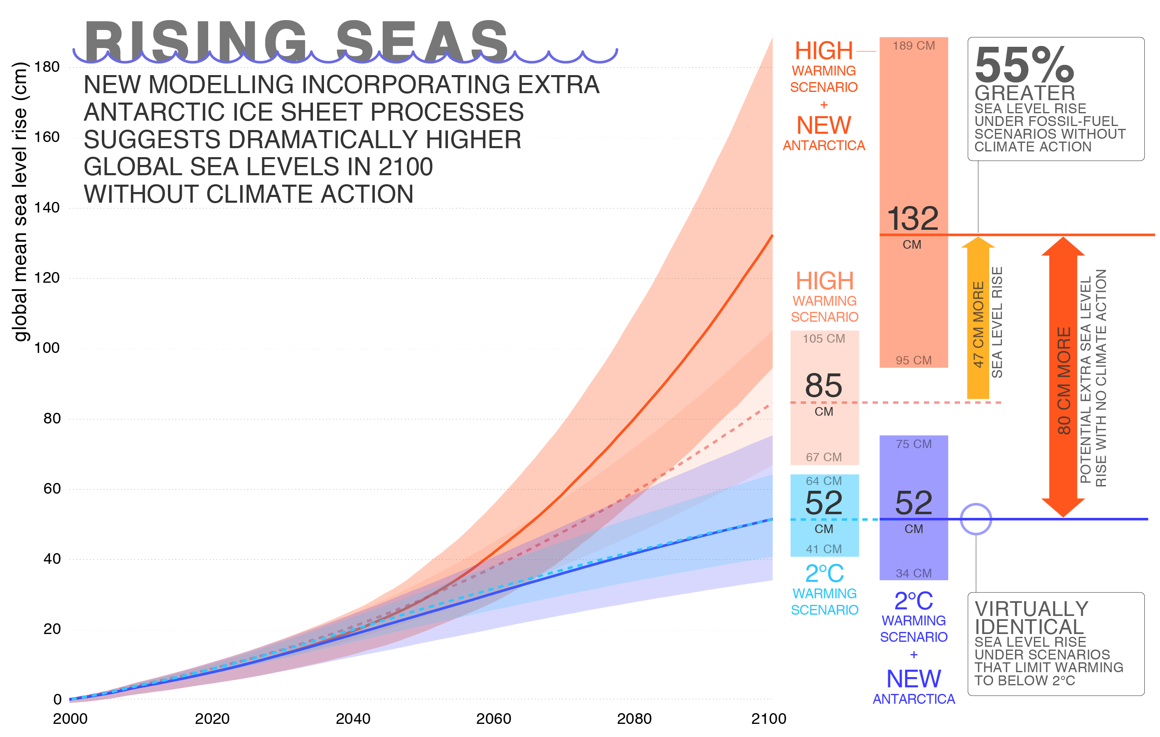
Nauels et al. 2017

Slide 39
Another example from the seas:
Coral Bleaching/Dieback
Degree heating months above historical threshold a good indicator for bleaching events.
If bleaching happens too often → likely dieback
Even under 1.5C or 2C scenario → Does not look good.
Frieler, Meinshausen et al., 2013; DOI: 10.1038/NCLIMATE1674

Slide 40
The light on the horizon

Slide 41
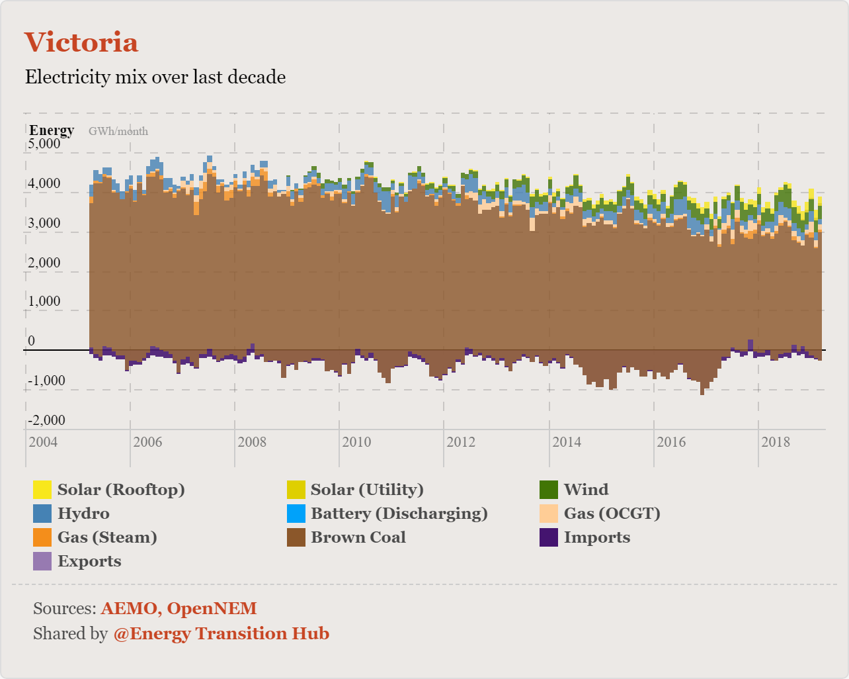

Slide 42
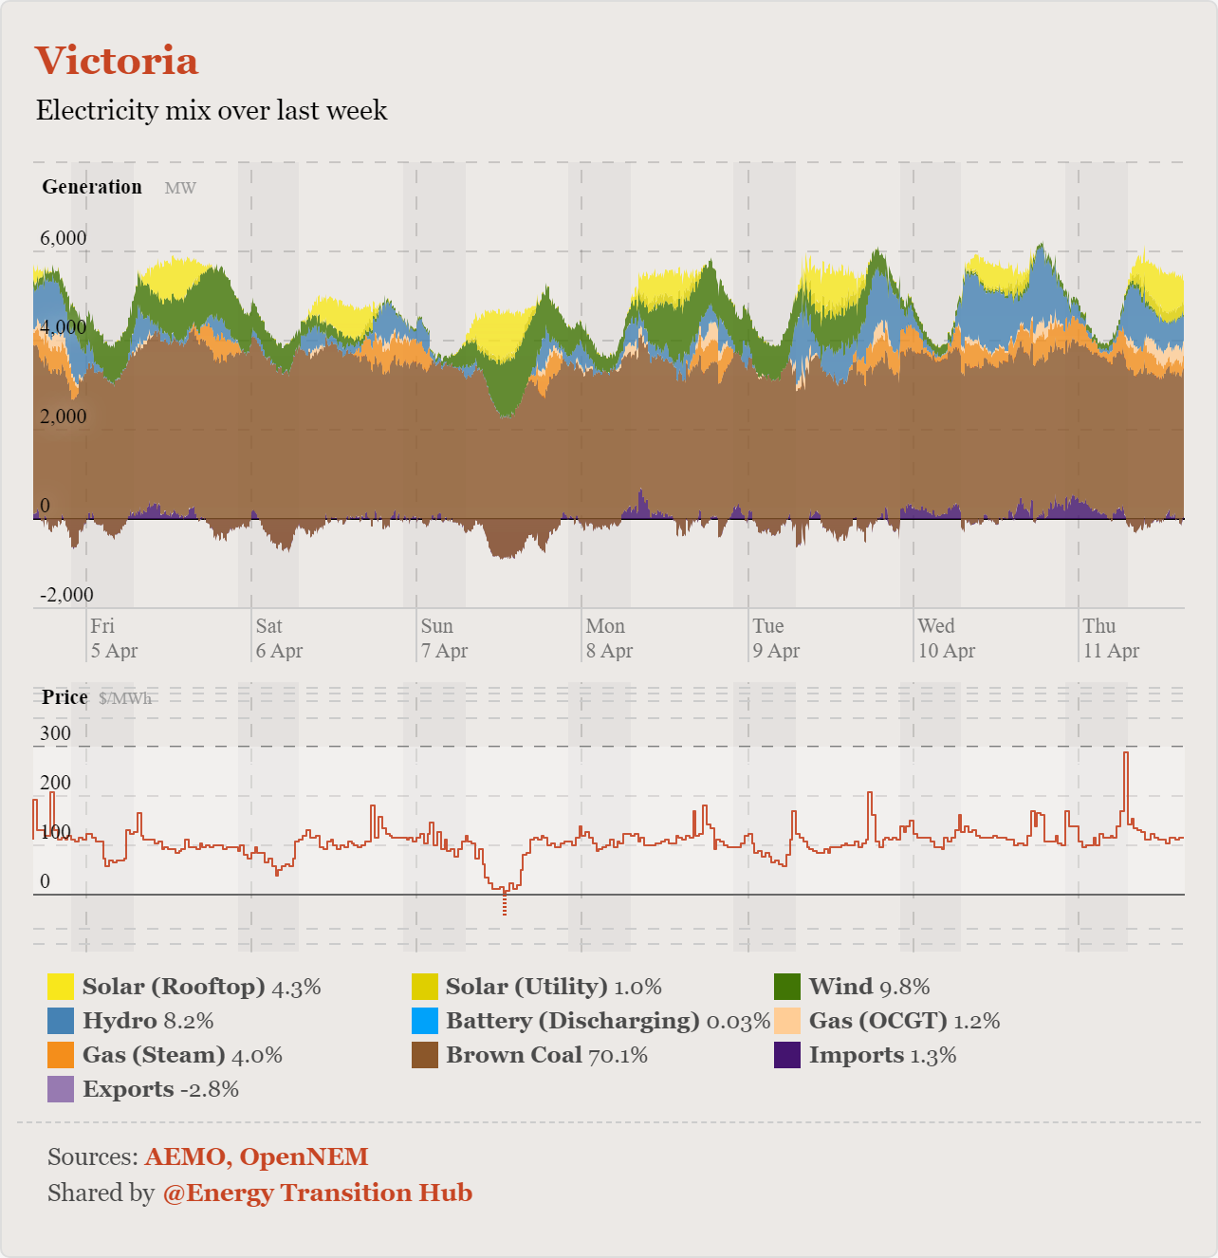

Slide 43
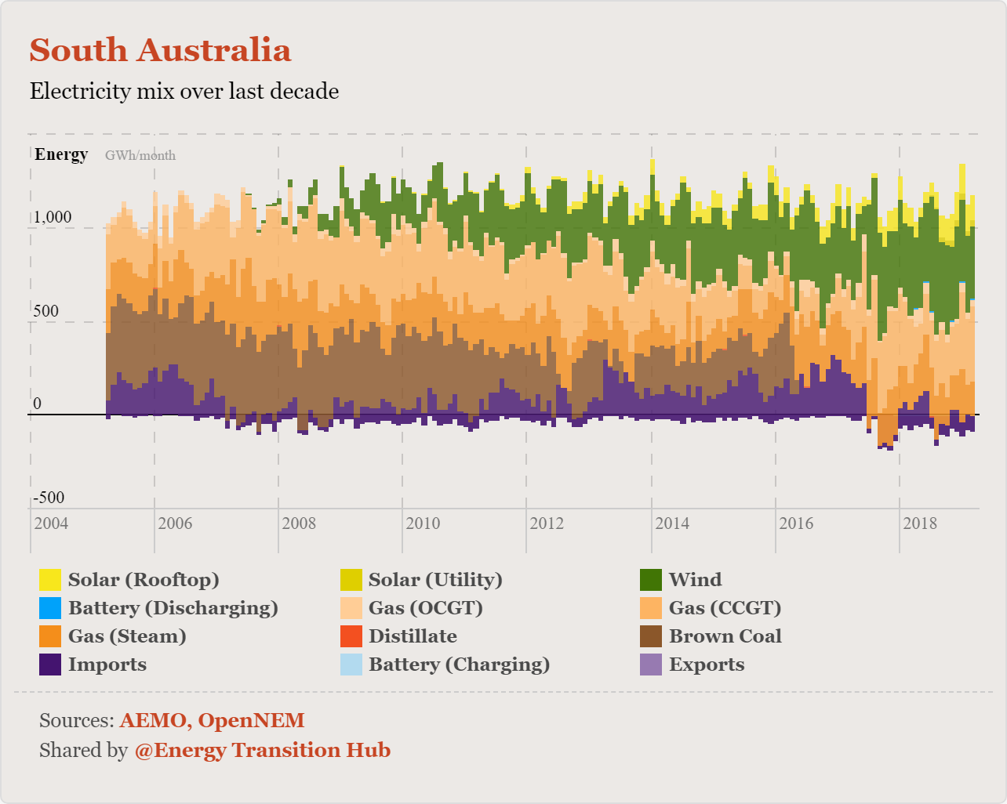

Slide 44
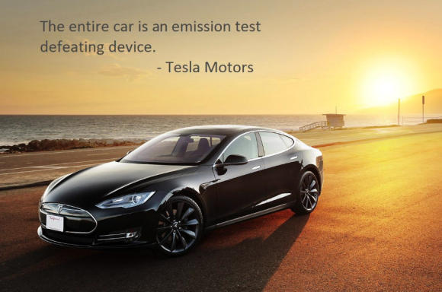
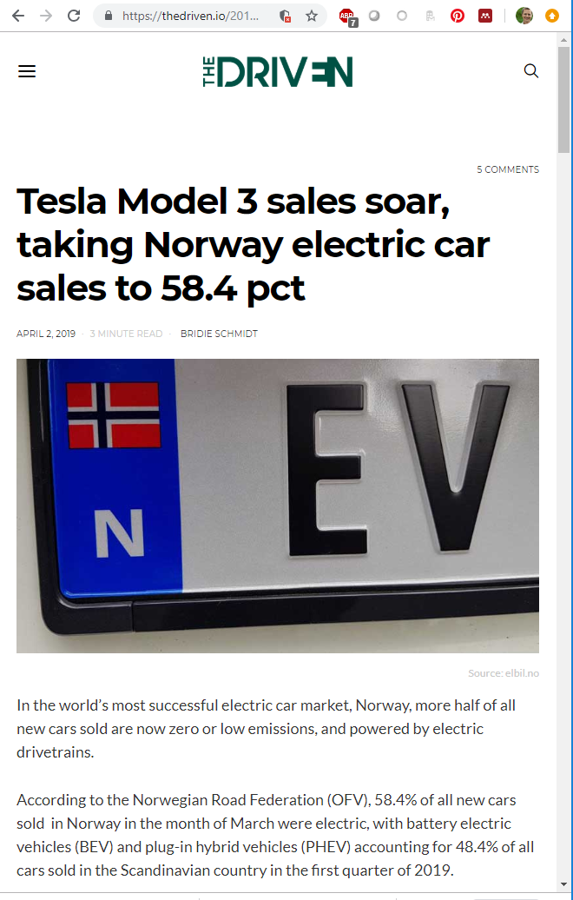

Slide 45
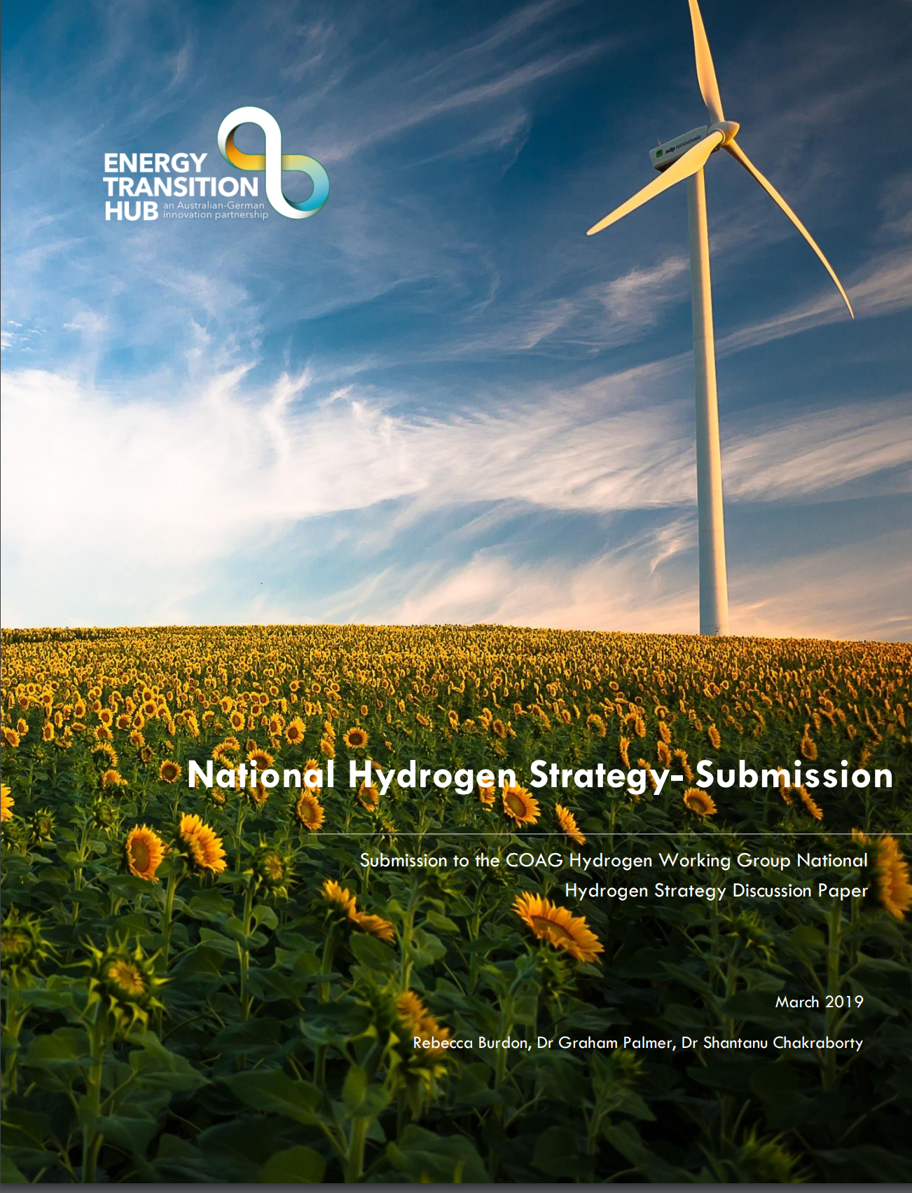
Australia’s potential if it pursued a 200% renewable scenario
If transmission planning and grid stability is handled well: Australia’s plentiful renewable energy resources could turn it into one of the developed countries with lowest electricity prices in a zero emissions world.
Large opportunities for exports. Directly in form of hydrogen and ammonia, or indirectly as green steel etc.

Slide 46
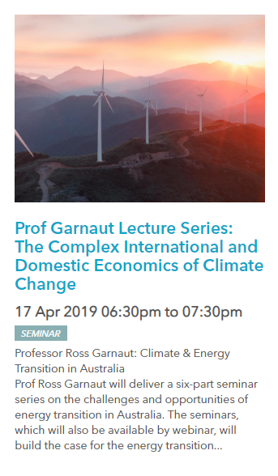
Next events & our websites
Climatecollege.unimelb.edu.au
Energy-transition-hub.org
Paris-equity-check.org
Opennem.org.au

