Slide 1

World Wind
&
Helsinki 2017
The Smartest of Smart Cities

Slide 2
Smart Cities Get Smarter by Thinking Together
Every city needs what every other city needs.
Why is each city solving this problem as if alone?
A smart city works in concert with other cities.

Slide 3

For the benefit of all

Slide 4


Notes:
Looking into deep space from our galaxy. . .there are over a 100 billion galaxies. . .each with over a 100 billion stars

Slide 5

Notes:
The Milky Way from somewhere inside Andromeda.

Slide 6
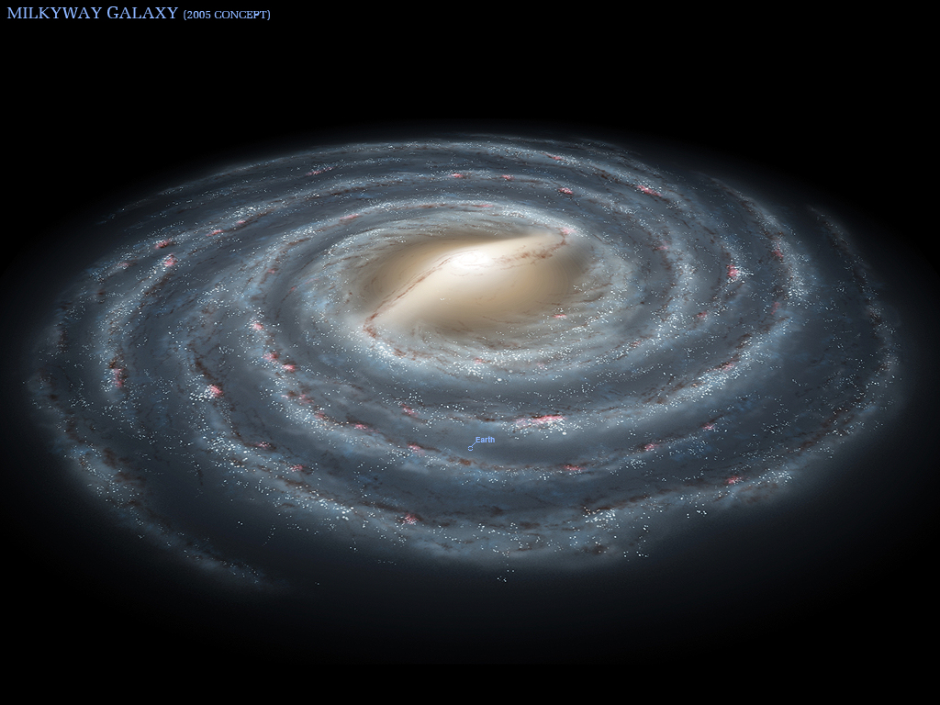
Notes:
The Milky Way

Slide 7
You are here!
Notes:
You are here!

Slide 8
Oops!
You were here!
Notes:
Oops! You are no longer here. . .

Slide 9

“Eyes look your last! Arms take your last embrace!” . . . or . . .
How beauteous mankind is! Oh brave new world that has such people in it!
Romeo or Miranda?
Notes:
“Eyes look your last! Arms take your last embrace!” . . . or . . .
How beauteous mankind is! O brave new world, that has such people in't!

Slide 10


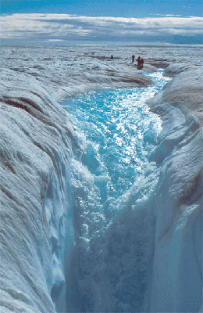









0
0
00000))00
00000000000
0000000000000

Slide 11
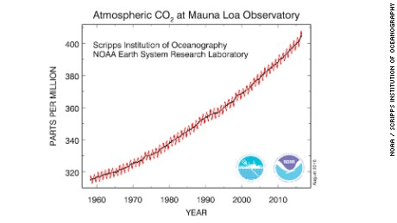
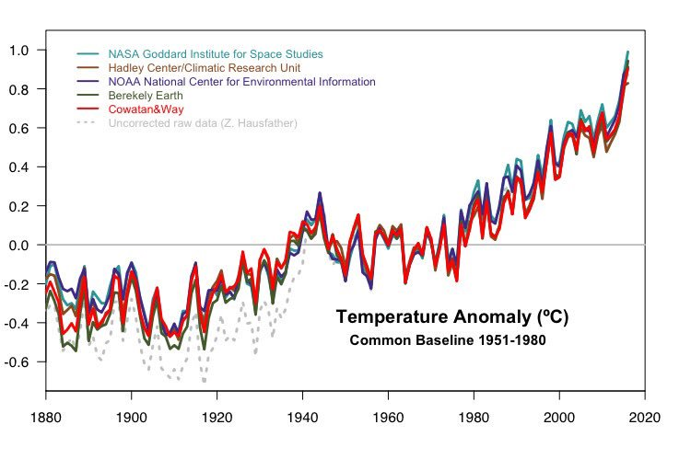
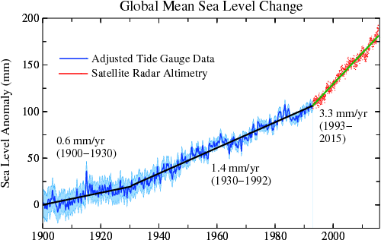
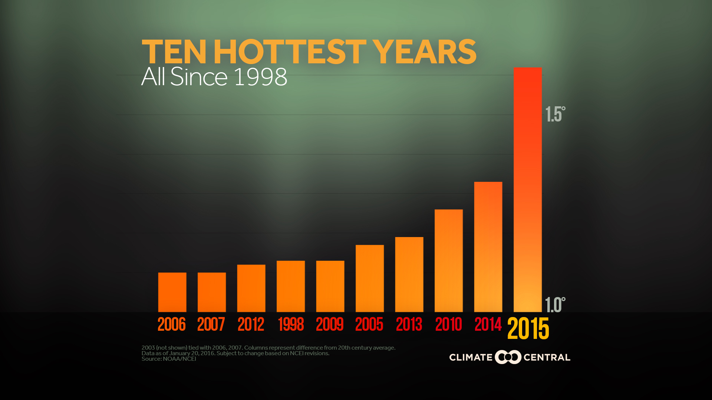
2016 was even hotter than 2015! 2017 is on track to do the same

Slide 12
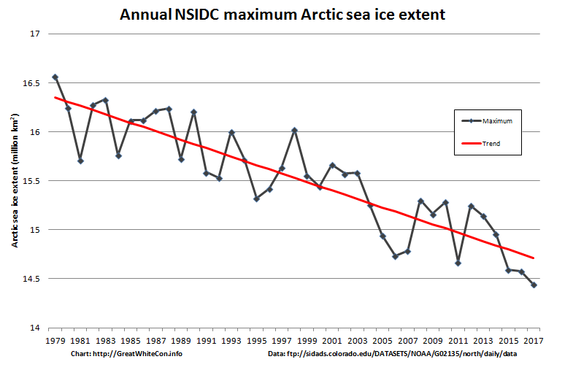
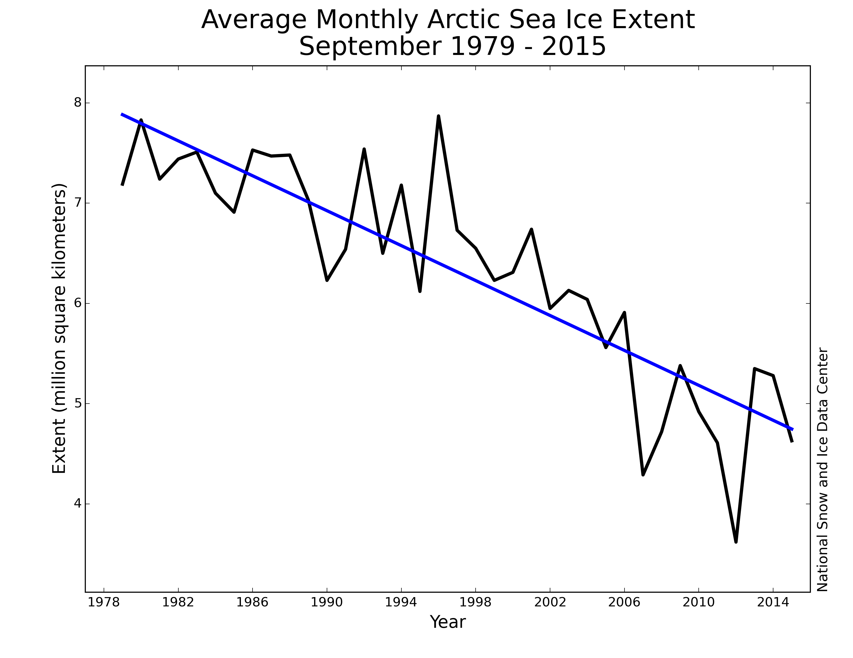
Sea Ice Extent
Maximum & Minimum

Slide 13
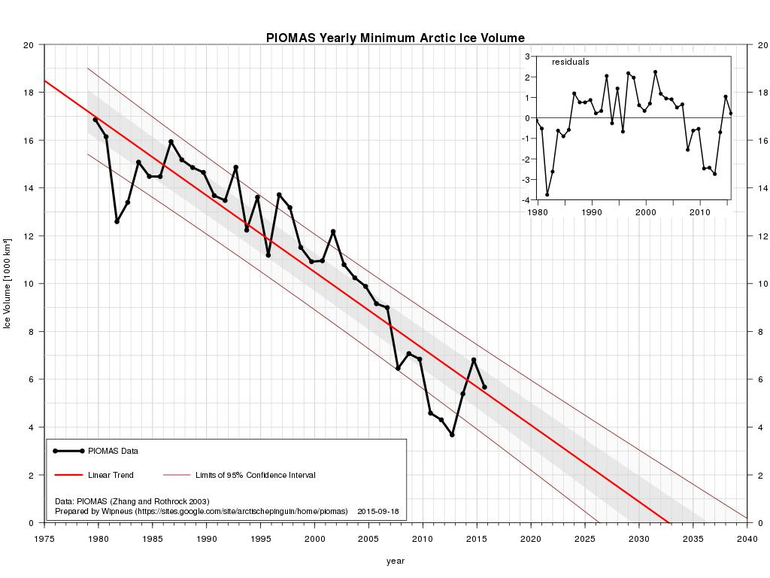
Sea Ice
Volume

Slide 14
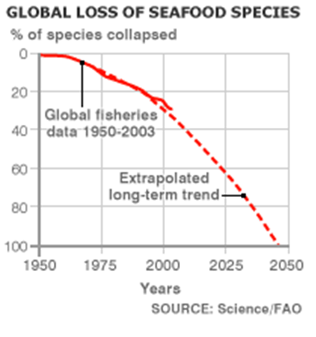
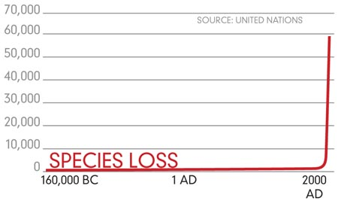

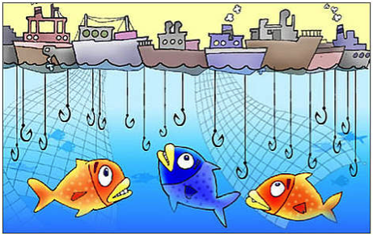

Slide 15
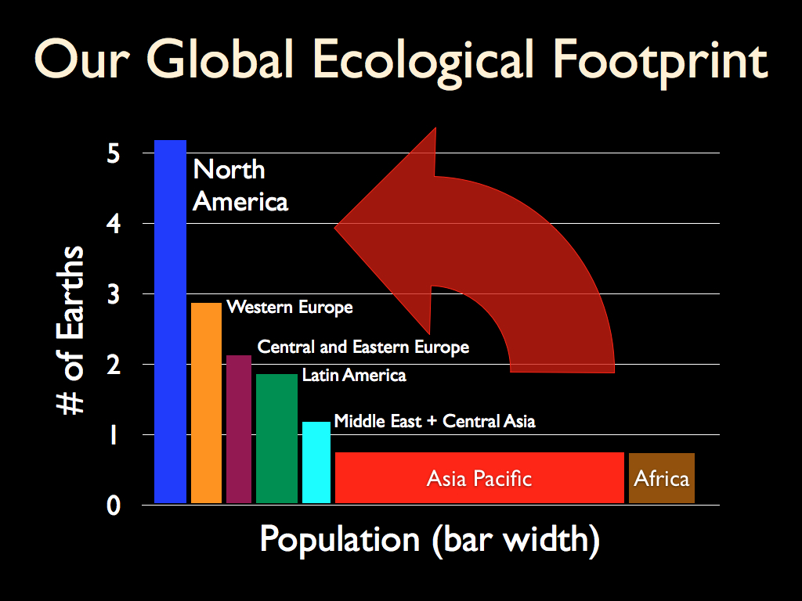

Slide 16
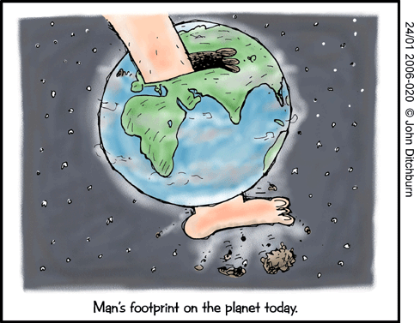

Slide 17
How Can Cities Be Smart Together?
The Magic Formula: Think Global Act Local
Open Standards for data format are essential.
National Directives help, i.e., US NSDI & EC INSPIRE
Open Source wherever and whenever possible.
Open Data wherever and whenever possible.
Common ‘open source’ platforms facilitate ‘big’ solutions.
Leadership counts! Build local solutions and share big!

Slide 18


US NSDI & EC INSPIRE Directives
US National Spatial Data Infrastructure
  …the technology, policies, standards, and human resources necessary to acquire, process, store, distribute, and improve utilization of geospatial data.
EC Infrastructure for Spatial Information for Europe
  …enable the sharing of environmental spatial information among public sector organisations, facilitate public access to spatial information.

Slide 19


Web World Wind
Jointly Developed By
&

Slide 20
World Wind
Accurate Earth context for spatial data.
API-centric modular componentry for any App.
Easily learned and quickly incorporated.
Fully extensible, add any functionality.
World’s longest running Open Source virtual globe.

Slide 21
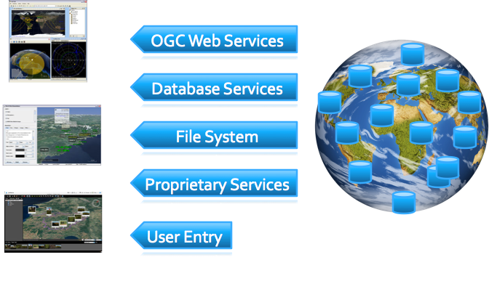
Any Data Source
World Wind

Slide 22
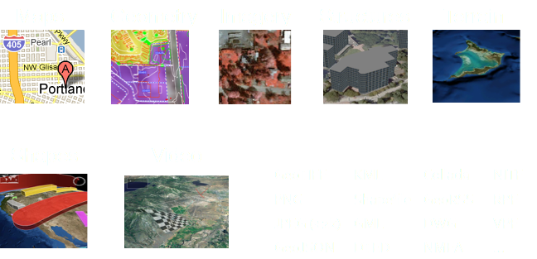
Any Data Type
World Wind

Slide 23
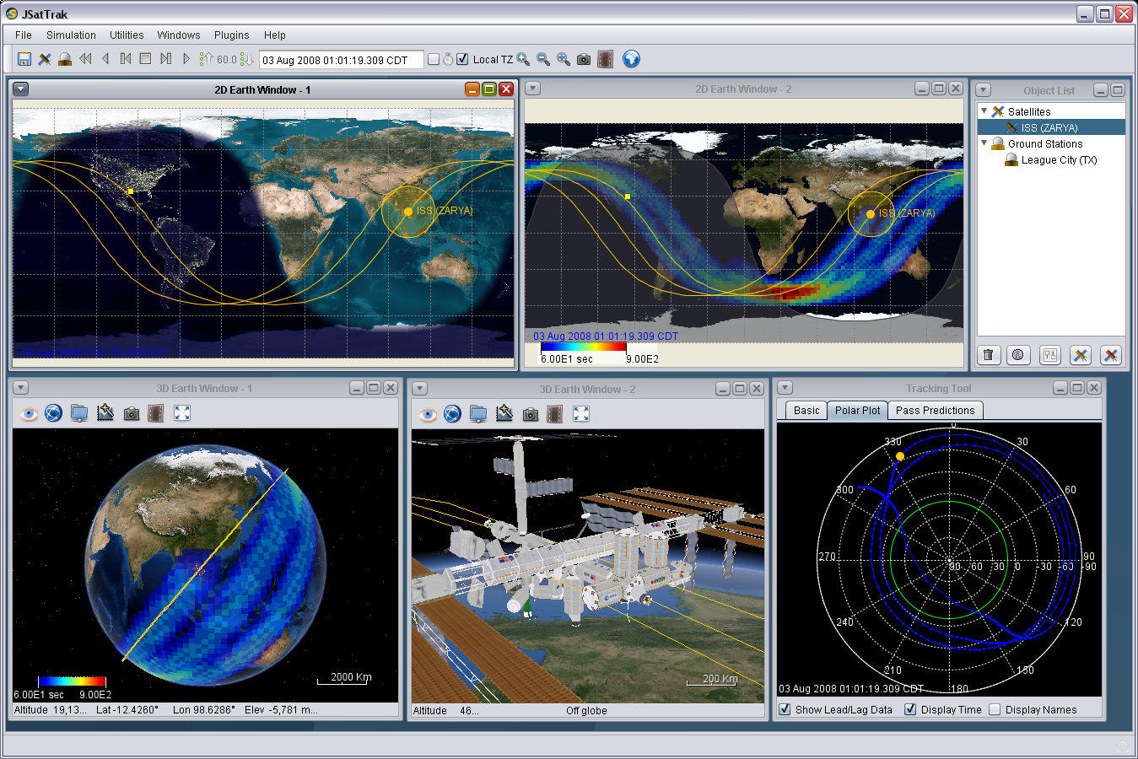
Any Data View
World Wind

Slide 24
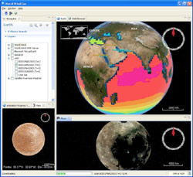
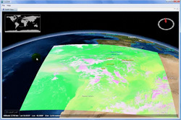
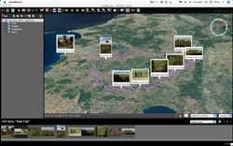
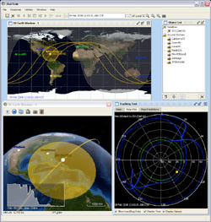
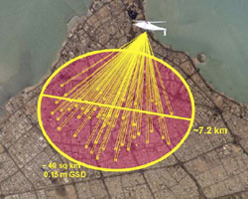
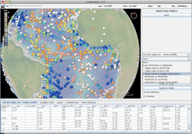
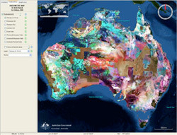
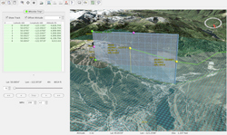
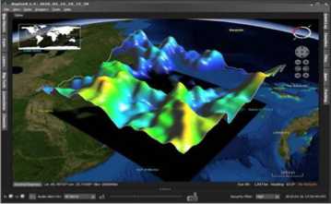
Not one app, any app you want. . .

Slide 25
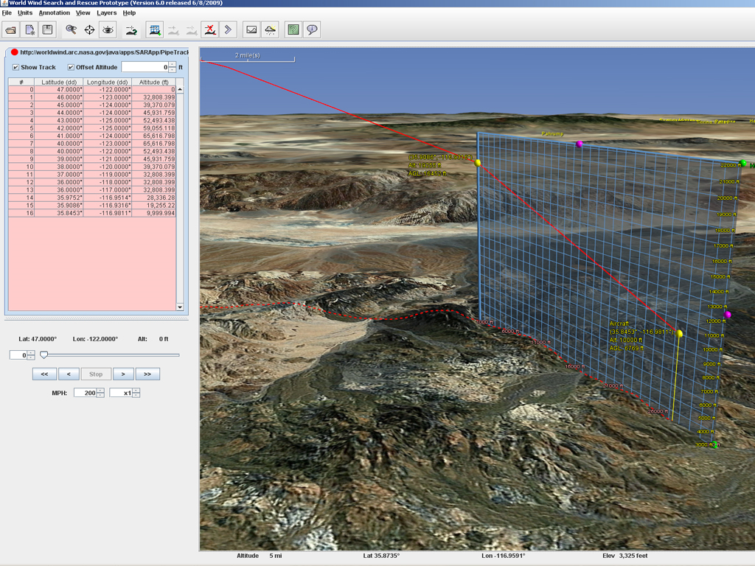
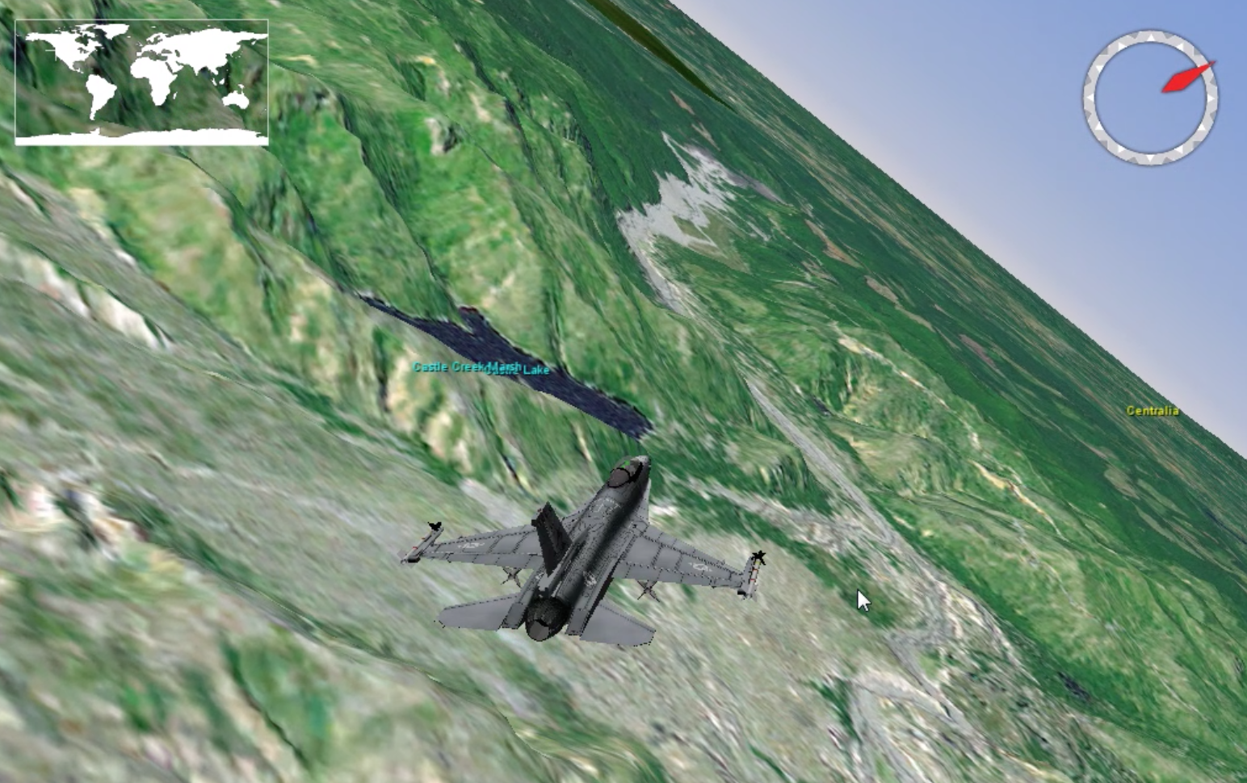
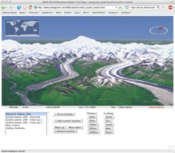
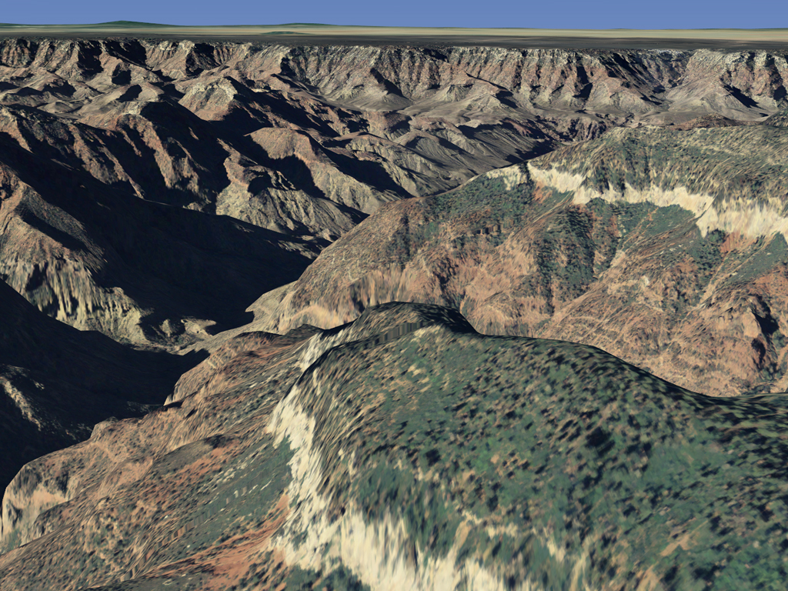
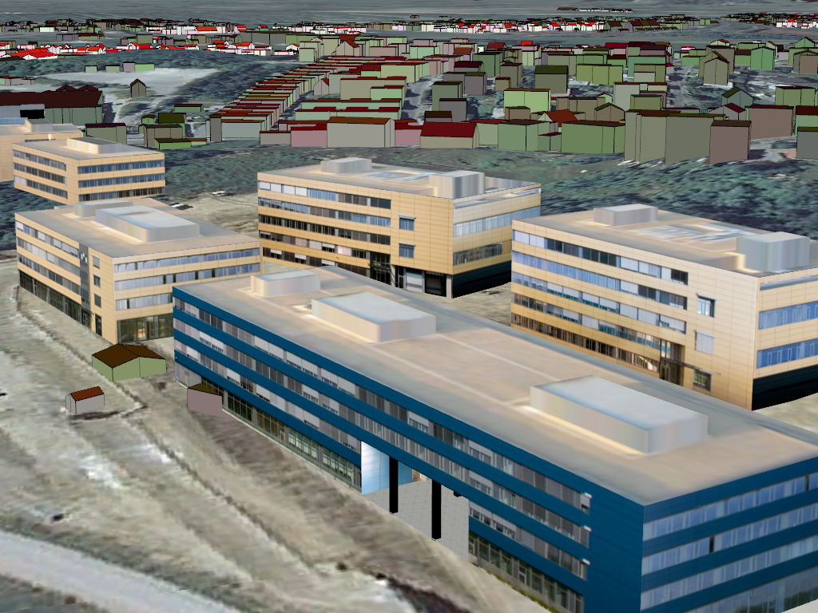
Flight Simulator
Almost like being there!
Every building for the country of Slovenia

Slide 26
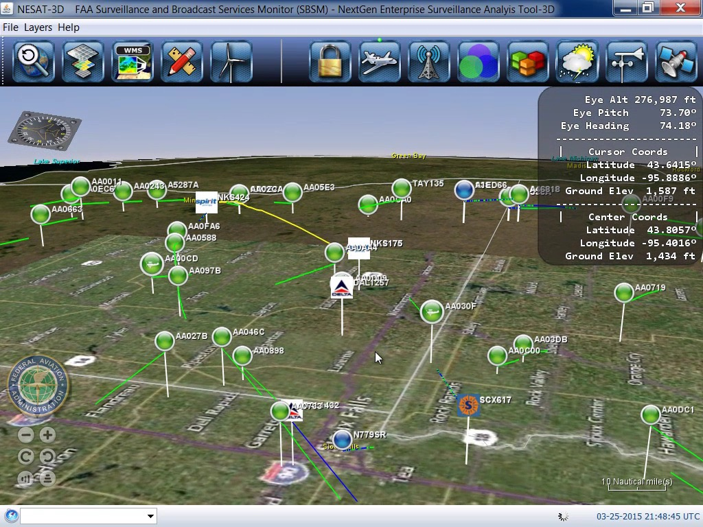
The FAA’s next-gen Air Traffic Management system
Notes:
In the air

Slide 27
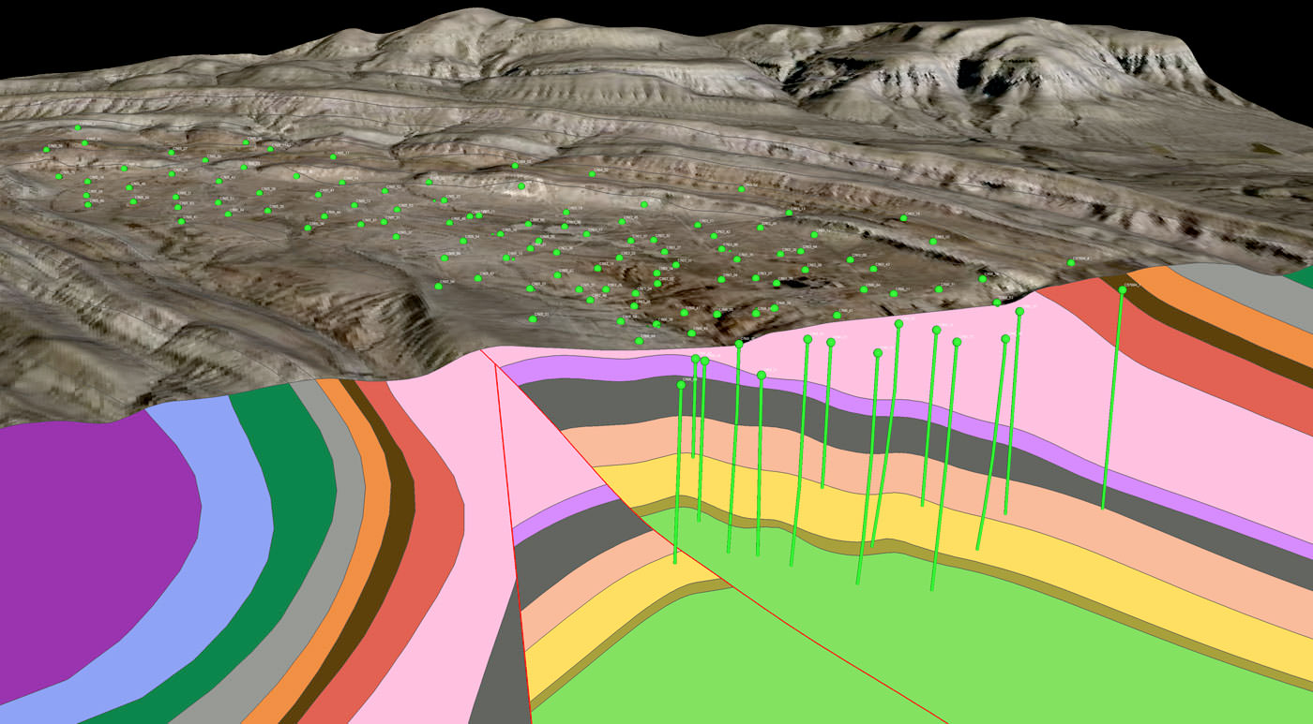
Sub-Surface
Image from Dynamic Graphics, Inc.
Notes:
Under ground (web version)

Slide 28
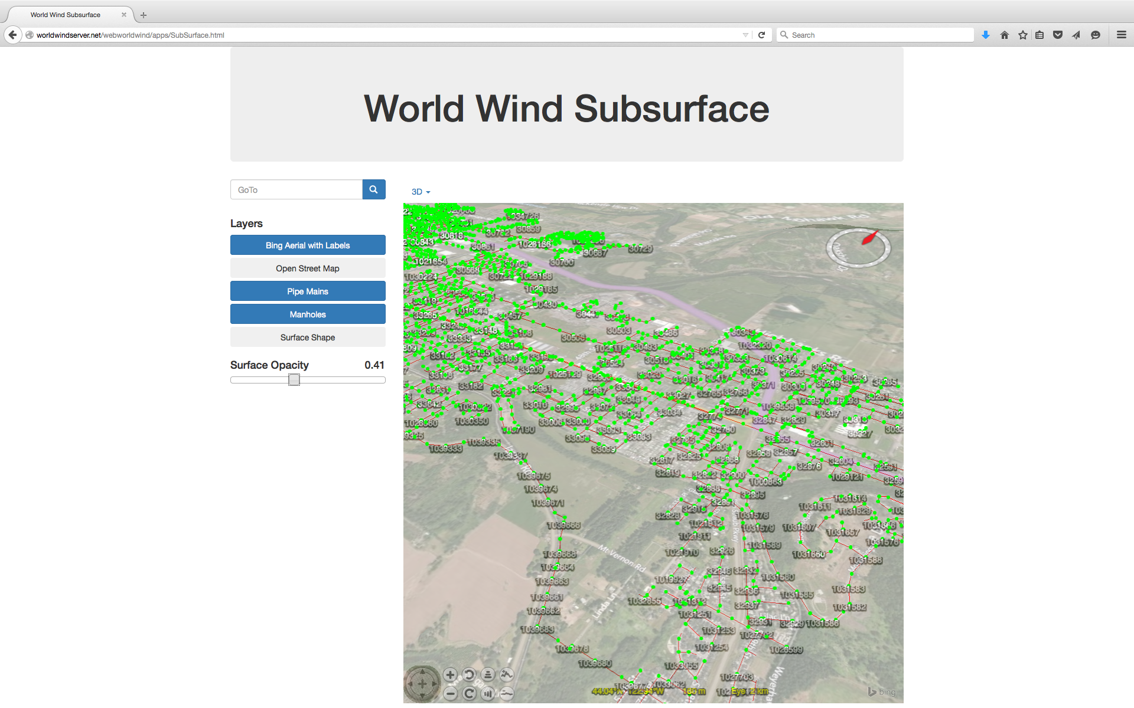
Notes:
Under ground (web version)

Slide 29
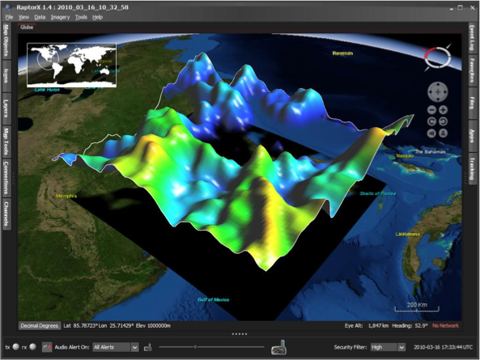
Interactive Analysis
4D data comes alive, plays like a movie
Notes:
Dynamically interact with data and the real world

Slide 30
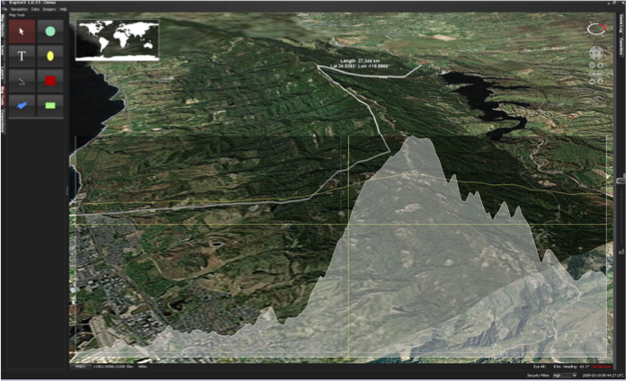
Interact with Terrain

Slide 31
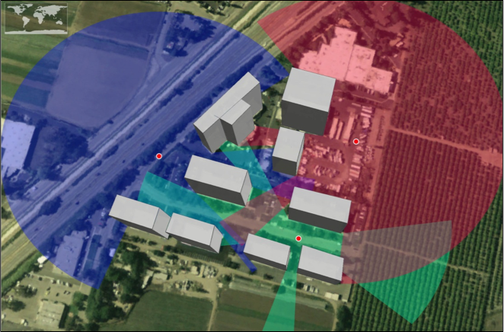
Interact with Buildings & Terrain
Line-of Sight

Slide 32

Architecture
Web World Wind
World Window
Canvas
WebGL
App
Globe
Terrain
Web
Layers
Imagery
Navigator
Shapes
Extensible Modular Componentry
Architected to extend indefinitely
Notes:
The basic architecture for visualizing your data.

Slide 33
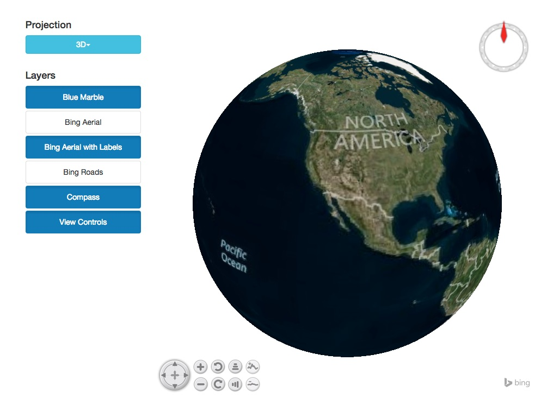
WorldWind Is:
Open-Source Virtual Globe.
Java, JavaScript, Android.
Library for use in any app or web page.
An Application Component,
not an ‘app’ itself.
If you want to see your data in native context,
just plug-it-in to your app.

Slide 34
WorldWind Provides
Geographic Context for Data and Information Visualization
Rich Set of Shapes and Graphics Primitives
Data Import From Anywhere: Local, Web, Cloud, Database, OSM,…
Provides Viewing, Picking, Scene Control, etc.

Slide 35
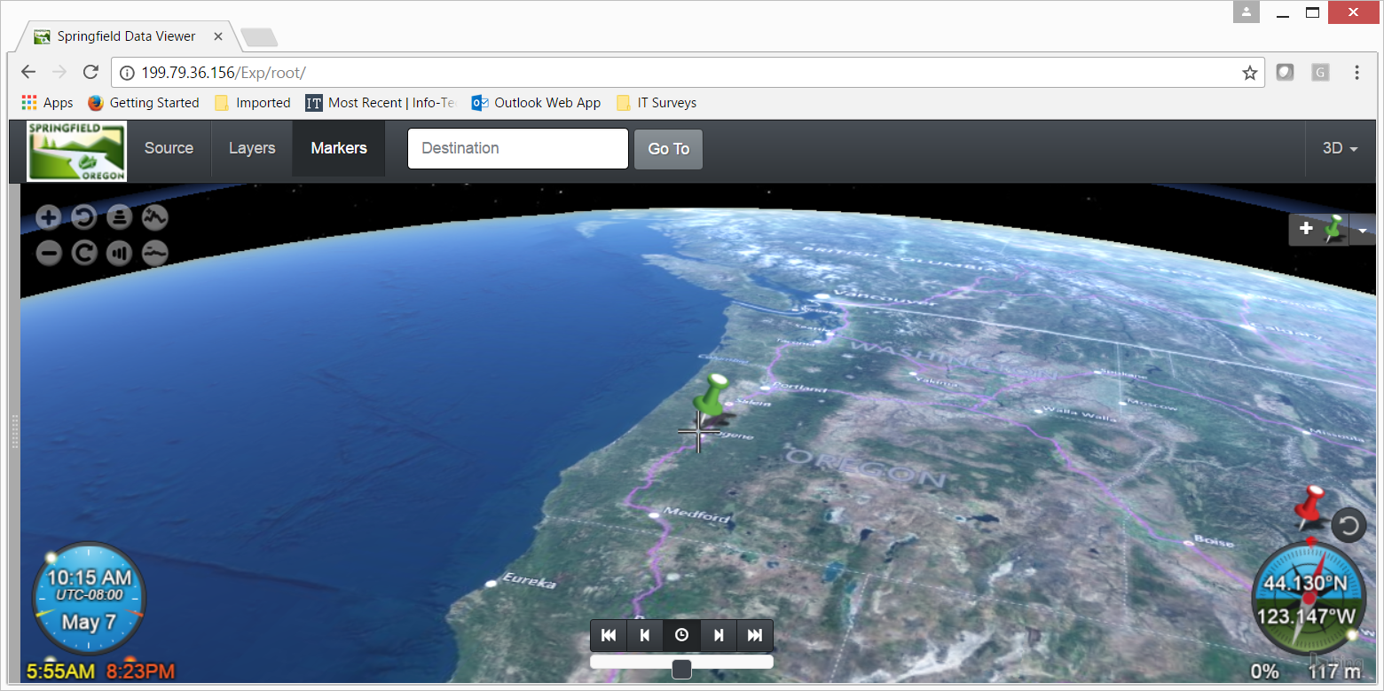
CitySmart
City of Springfield, Oregon
Case study – CitySmart
Lat/Lon at cursor
Angle of Sun (red)
Terrain slope
(flat in this case)
Local Time
Sunrise & Sunset

Slide 36

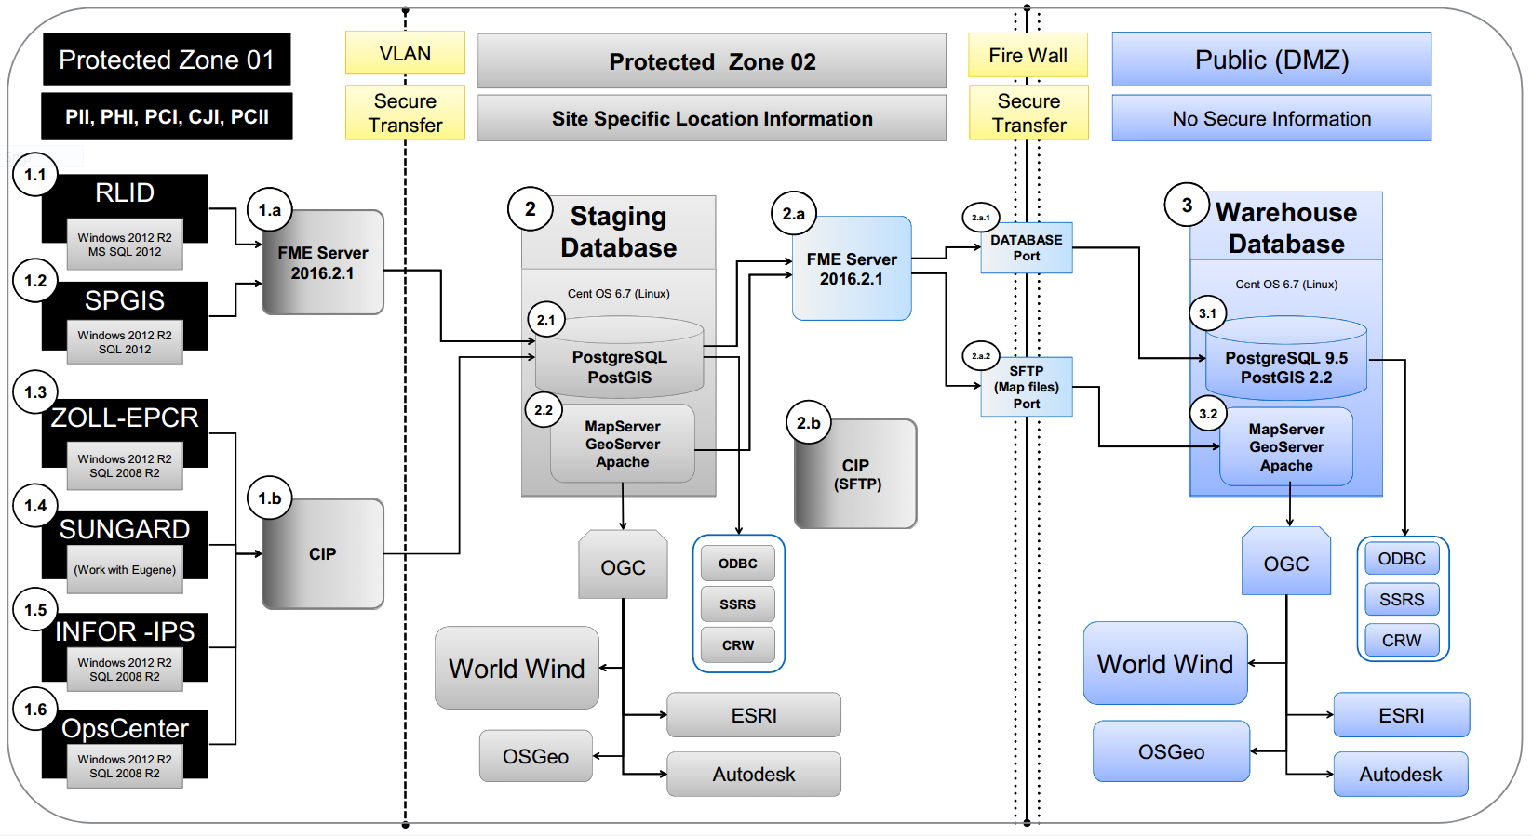
Infrastructure the Back-end
Notes:
Infrastructure:
Segregate protected zone one, containing sensitive/production information
RLID – Regional Land Information System
SPGIS – Springfield GIS information (facilities, natural resource, planning, etc.)
Zoll – ambulance services (911, transport, etc.)
Sungard – police services (911, community policing, criminal justice, etc.)
OpsCenter – Emergency Operations services
Establish a protected zone to for warehousing purposes, redaction, etc. (staging database)
Open source database to store views, queries, reports, etc.
Spatially enable the database (handle most geo types and GIS database functions)
Mapserver or Geoserver and apache to publish OGC compliant services
Provide a hardened and fully redacted outward facing Public instance
Between all zones use encrypted electronic transform and load (ETL) services
Why – protect personally identifiable information of citizens and protect public assets (data and systems) from attack

Slide 37

World Wind
Lidar Development
Data Prep Datum and projections Raster indexing Point thinning and viewing Indexing Image Infusion GeoTiff WMS LAS infusion SHP WMS WFS | Indexing (cont.) Point filtering/rendering controls: Elevation Classification Intensity Return No. Point source ID Scan angle RGB User defined data Height | Indexing (cont.) Batch processing Import/export Use in WW Image/LAS infusion Point filtering DEM creation

Slide 38
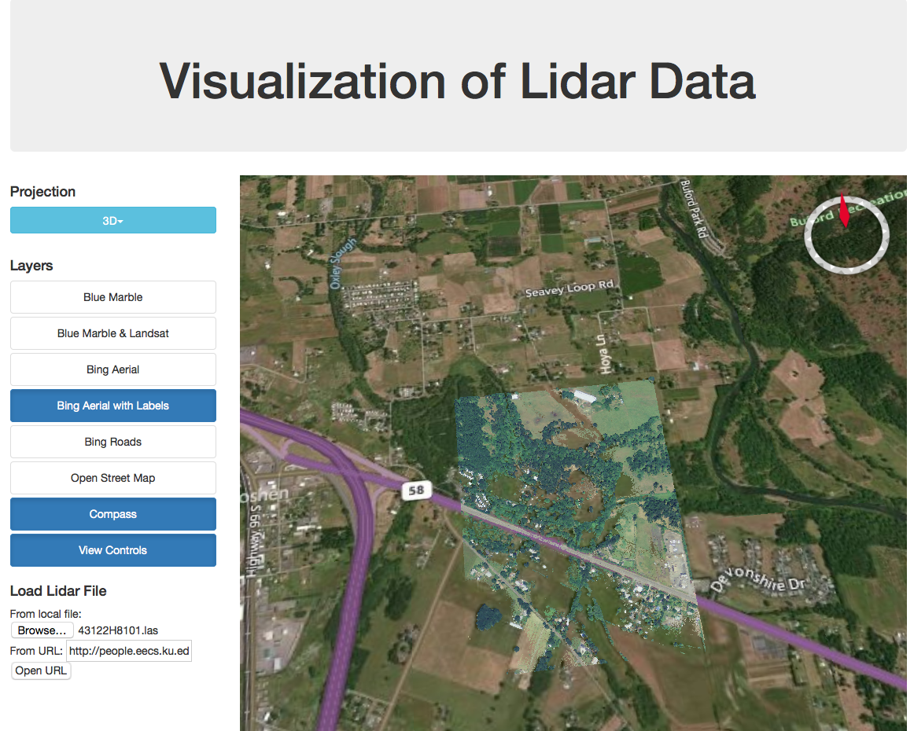
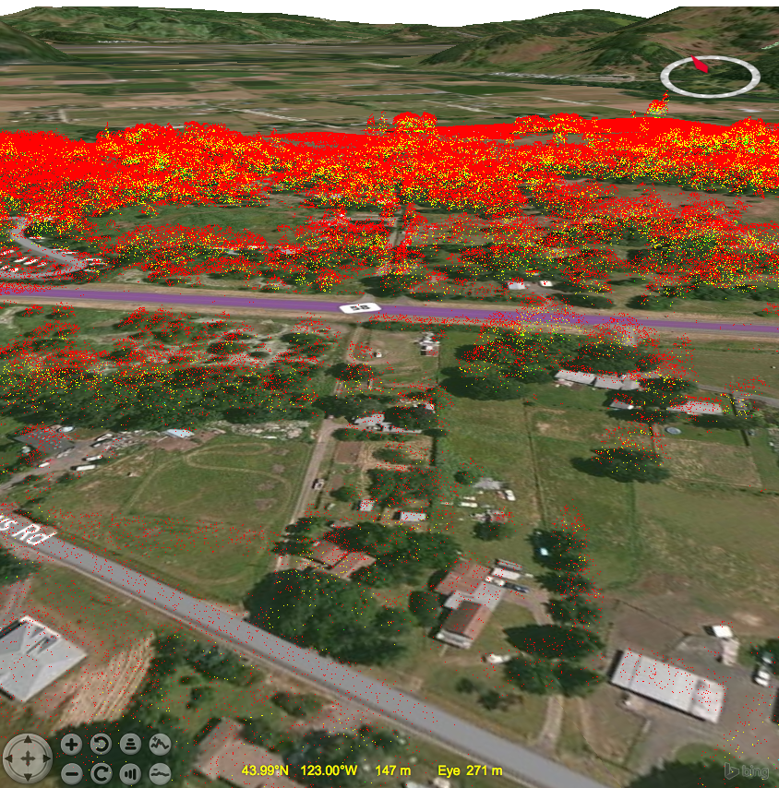
Notes:
Under ground (web version)

Slide 39
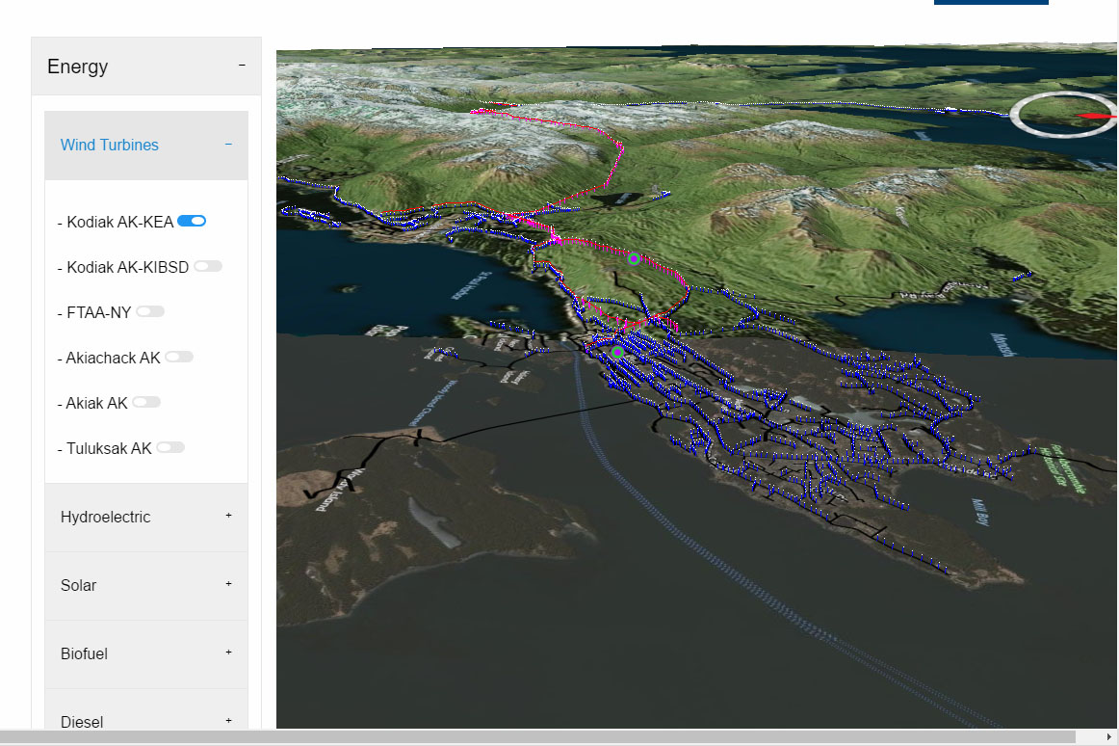
Springfield
partnering with
Kodiak Alaska
and their
City Smart development activity.
Every single transmission pole,
and all underground lines
Notes:
Worldwind:
Borrow from the best
Work with the best
Initial efforts to build elemental components
System exploration with Patrick Hogan and Dave Collins
Lidar with Jim Miller
Security with Vinith Menon from India
Basic principle … ‘comes a time when the blind man takes your hand and says, cant you see . . .’ (connect the points, each endpoint has a particular expertise, create a mesh network . . . A Kevlar mesh network that will last the test of time.
Why – we cannot do it alone.

Slide 40
World Wind
For the benefit of all

Slide 41
Smart Cities Get Smarter by Thinking Together
Every city needs what every other city needs.
Why is each city solving this problem as if alone?
A smart city works in concert with other cities.

Slide 42
Helsinki Europa Challenge
http://eurochallenge.como.polimi.it/
Helsinki Finland! August 2017!
The Europa Challenge is a world challenge, to bring the world closer together through urban management solutions that YOU build and share with every other city!
Develop solutions serving your community needs that benefit every other city!
Almost every city needs the same data management ^tools^ as every other city.
How can we help cities work together to be more sustainable and more livable?
If cities were able to share their solutions with each other, this would multiply their investment by the number of cities participating.
Each city could develop different functionalities and then 'share' these results
with each other, massively increasing our planet's collective productivity.

Slide 43
World Wind
&
Helsinki 2017
The Smartest of Smart Cities

